Slide 1
American Society of Plumbing Engineers
2022 Region Meetings
Updates for Chapter Leaders from the Society’s Board of Directors and Staff

Slide 2
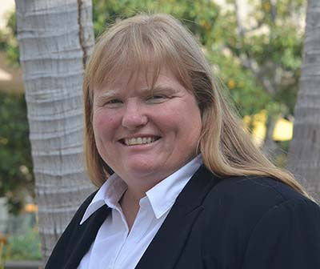
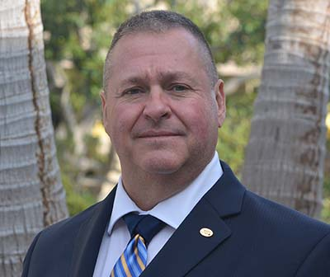
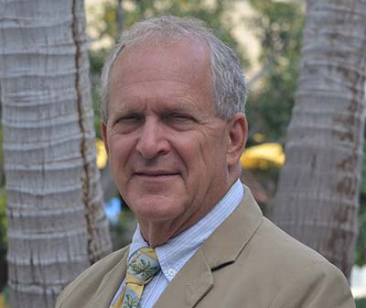
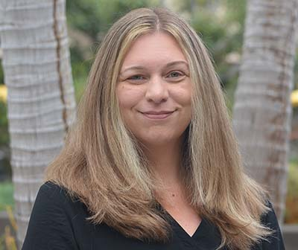
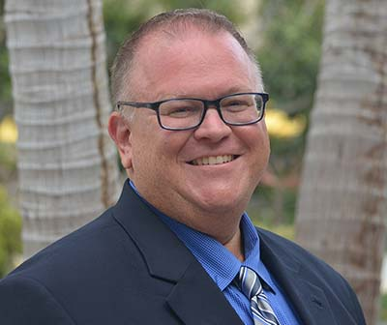
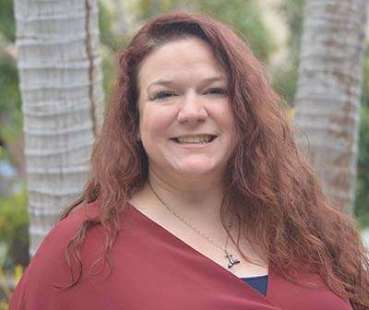
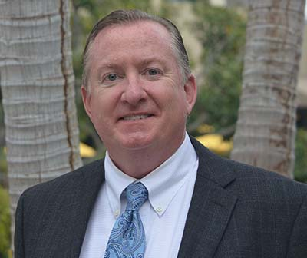
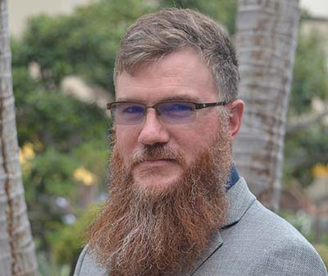
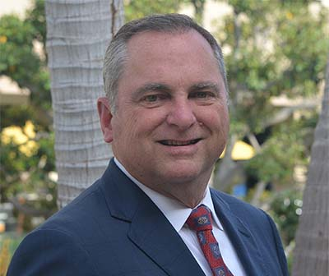
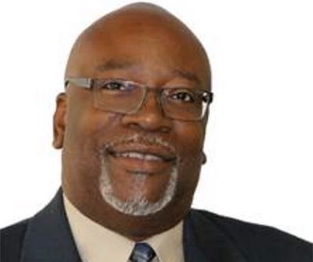
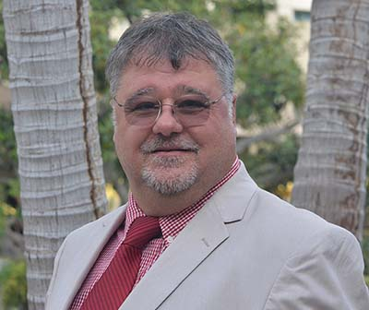
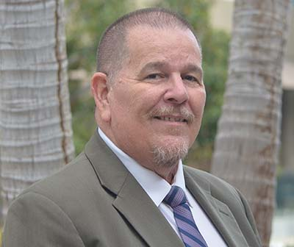
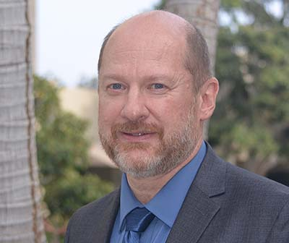
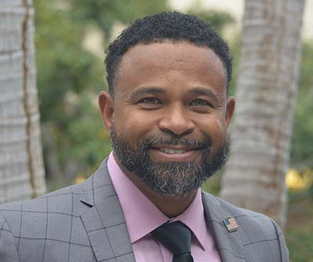
Vincent (Vinny) Falkowski PE, PMP, CCM
VP, Technical
Jim Zebrowski
PE, CPD, FASPE
VP, Education
Brianne N. Hall, PE, CPD, LEED AP BD+C, GGP
VP, Legislative
Jason S.A. McDonald CPD
VP, Membership
Carol Johnson
CPD, LEED AP, CFI, FASPE
President
ASPE
Board of
Directors
Blair Minyard
PE, CPD, CDT
Treasurer
Thomas P. Sharp
Vice President, Affiliate
Nicholas Hipp
CPD
AYP Liaison
Billy Smith
FASPE
Executive Director/CEO & Secretary
Donald Keith
CPD, FASPE
Region 1 Director
Steve J. Kormanik CPD, GPD
Region 2 Director
Curtis A. Ray, Jr. CPD, FASPE
Region 3 Director
Duane D. Lease
PE
Region 4 Director
Bryan Hutton
CPD
Region 5 Director

Slide 3
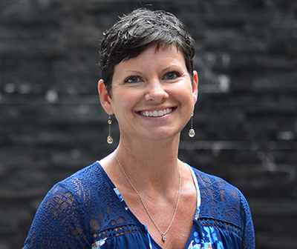
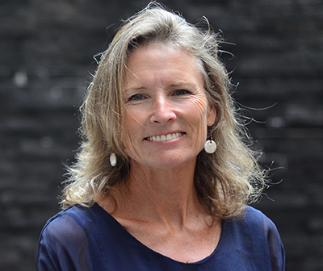
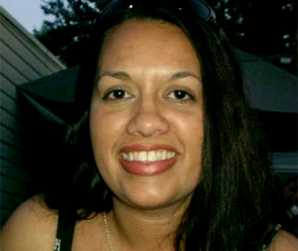
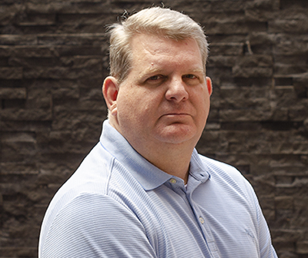
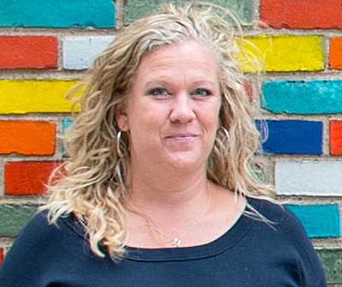
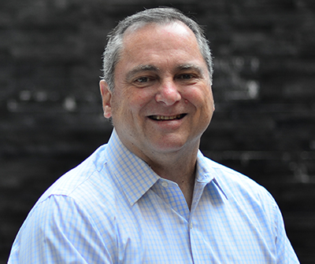
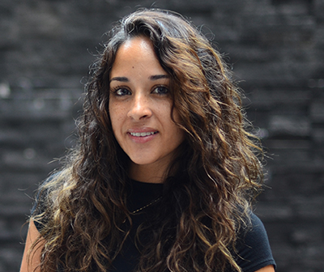
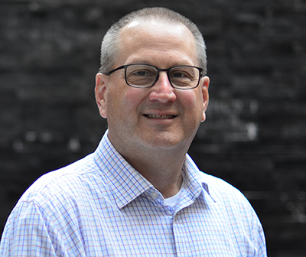
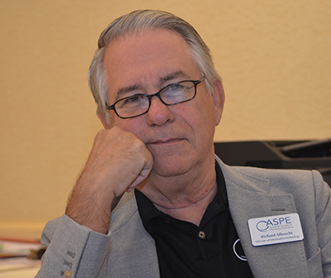
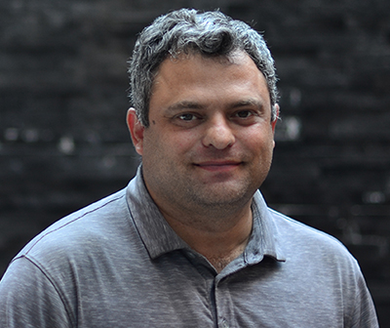
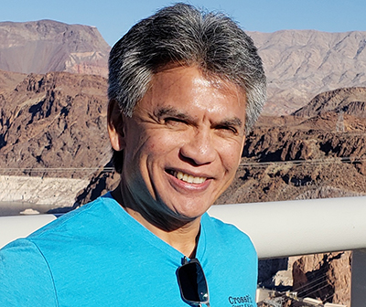
Billy Smith
FASPE, Executive Director/CEO
Cliff Reis
Managing Director/Director of Meetings
Gretchen Pienta
Director of Communications
& Publications
Racquel Rodriquez
Membership Coordinator
Lisa Gonzalez
Membership & Chapter
Meeting Coordinator
Brian Henry
Director of Affiliate Relations
& Education
Richard Albrecht
Director of Information
& Technology
Eitan Gauchman
Sr. Manager of Finance
& Administration
Ramiro Mata
Sr. Director of Technical
& Regulatory Affairs
Nadine Saucedo
Manager of Graphics
& Website Design
Nichole O'Connor
Manager of Education
& Certification
Lisa Gonzalez
Chapter Education/Registration Coordinator
ASPE Staff

Slide 4
ASPE’s Commitment to the Industry
Notes:
ASPE is involved in the Plumbing Engineering Industry on a large-scale basis.
It’s important to continue advancing ASPE’s brand.
It’s important to continue allowing our volunteers the opportunity to use their talents to advance the protection of the health, welfare and safety of the public on a Global basis.

Slide 5
Who We Are
The American Society of Plumbing Engineers (ASPE) is the international organization for professionals skilled in the design, specification and inspection of plumbing systems. ASPE is dedicated to the advancement of the science of plumbing engineering, to the professional growth and advancement of its members and to the health, welfare and safety of the public.

Slide 6
Where We Are
  Industry Involvement – ASHRAE, ASME, ASTM, AWE, AWWA, CIPH, CDA, CSA, IAPMO (IWSH, CPC, UPC, WE-STAND), ICC (IPC, BSM), NSF, PHCC, PMI, PPFA, PPI, WQA, WPC
  Co-Convener Efforts – EWTS, PILC, PERC
  Global Touchpoints – Engineers Week, World Plumbing Day, World Water Day
Notes:
ASHRAE – American Society of Heating, Refrigerating and Air-Conditioning Engineers
ASME – American Society of Mechanical Engineers
ASTM – American Society of Testing and Materials
AWE – Alliance for Water Efficiency
AWWA – American Water Work Association
CIPH – Canadian Institute of Plumbing & Heating
CDA – Copper Development Association
CSA – Canadian Standards Association
IAPMO – International Association of Plumbing & Mechanical Officials - IWSH – International Water, Sanitation and Hygiene Foundation, CPC – Community Plumbing Challenge, UPC – Uniform Plumbing Code, We-Stand – Water Efficiency and Sanitation Standard
ICC – International Code Council, IPC – International Plumbing Code,, BSM – Building Safety Month
NSF – National Sanitation Foundation International
PHCC – Plumbing-Heating-Cooling Contractors
PMI – Plumbing Manufacturers International
PPFA – Plastic Pipe and Fittings Association
PPI – Plastic Pipe Institute
WQA – Water Quality Association
WPC – World Plumbing Council
EWTS – Emerging Water Technology Symposium
PILC – Plumbing Industry Leadership Coalition
PERC – Plumbing Efficiency Research Coalition

Slide 7
New & Improved
ASPE strives to continue improving existing benefits while also seeking to add additional member benefits as we move forward.
Examples:
Online Multi-Chapter Membership
New Member & Renewal Applications
New ASPE Merchandise Store
New Medical Gas Training Course
Newly Revised CEU Provider Program
Chapter Meeting/Event Announcements & Pictures via Pipeline
New FAQ webpage
Notes:
Online Multi-Chapter Membership - Now, members can join multiple chapters online. In the past, to do so, calling the Society office was required.
New Member & Renewal Applications – Recently, staff has completed an extensive update to both our new member & member renewal applications.
New ASPE Apparel Store – Recently, the third-party provider that managed ASPE’s store, decided to leave the industry. Therefore, staff acted quickly and effectively to bring a modernized process which allows ASPE members a broad array of vendors of which may be used. Enjoy!
New Med-Gas Training Course – This will benefit ASPE members and will provide them with the required 32-hours of training that will allow to sit for a Med-Gas credential as desired.
Newly Revised CEU Provider Program - New pricing to benefit sponsors, Pricing for non-sponsors is higher, We are promoting those who help us financially, Continues to be very beneficial to membership, Great for maintaining CPD & CPDT recertification
Chapter Meeting/Event Announcements & Pictures via Pipeline – This is a new feature we’ve just added recently that will allow ASPE Chapters to send to Gretchen Pienta a Chapter prepared meeting or event announcement which will be placed in the Pipeline that will allow other members around the country to participate is they so desire. Pictures can also be share from meetings or events that were held which Society can later use within our ASPE marketing development efforts and social media outreach when needed.
Created to answer A LOT of frequently, yet simple questions, the Frequently Asked Questions page is geared to lighten up calls to IT and Membership.

Slide 8
New & Improved (continued)
90-Day Membership Extension: - A reminder of the Board of Directors’ decision to allow a 90-day extension to all members due to the pandemic when it first began. This has been most helpful in assisting the Society’s membership retention efforts. This is just one component of our overall retention efforts; however, we’ve seen a total of approximately 2,300 members retained during this time.

Slide 9
Society & Membership Initiatives

Slide 10
Multi-Year Membership Renewal
Program is available to new and current members.
Renew for two years to receive 5% off dues payment and pay $361.
Renew for three years to receive 10% off dues payment and pay $513.
To date, 401 members are taking advantage of this initiative.
Notes:
Multi-Year Membership Renewal
There are 401 active members utilizing this multi-year discount.
Now you can save on your ASPE membership dues if you join or renew for more than one year. Current and new members will get a 5% discount for a two-year renewal and a 10% discount for a three-year renewal. Thus, members opting to join or renew for two years would pay $361 for both years, representing a $19 discount, and members opting to join or renew for three years would pay $513 for three years, representing a $66 discount.

Slide 11
Multiple Chapter Affiliation
Program is available to new and current members.
A new addition is that Members can get involved as a multiple chapter member via the online process.
Home Chapter affiliation is the standard dues rate of $190.
Additional Chapter affiliations are $80 per Chapter.
No limit to the number of Chapters with which a member can affiliate.
Board participation is allowed for any Chapters with which the member is affiliated.
Participation as a Delegate is only allowed with the Home Chapter.
To date, 43 members have multiple Chapter affiliation.
Notes:
There are 43 active members with multiple Chapter affiliations.
The first Chapter affiliation is the standard dues of $190.
Additional Chapter affiliations are $80 per Chapter. There is no limit to the number of Chapters with which a member can affiliate.
The member must designate a Home Chapter.
Regardless of the Home Chapter affiliation, the member can serve on the Board of Directors for any Chapter with which the member is affiliated.
However, the member can only serve as a Convention Delegate for his/her Home Chapter.
Members affiliating with multiple Chapters will receive only one Plumbing Engineering Design Handbook (PEDH) per year when renewing.
Contact the Membership Department at 847-296-0002 for more information or to affiliate with multiple Chapters.

Slide 12
Early Renewal Discount for First-Year Members
Renew by the end of the eighth month of membership and receive a reduced dues
amount of $170.
Only 125 members per quarter can take advantage of the offer.
Renewal must be done online at
aspe.org/membership-global-community/join/member-renewal/.
Over the past year, 0 members have participated in this initiative.
Notes:
Early Renewal Discount for First-Year Members
Over the past year, 0 members have used this discount to date. Previously,13 members used this discount in 2019. This program has not been used since.
After you join ASPE for the first time, you can ensure continued membership benefits at a discount by renewing early. Any first-year member who renews by the end of the eighth month of their membership will receive a reduced dues amount of $170 for the second year, therefore saving $20 by renewing early.
Eligibility guidelines for this discount follow:
Only 125 members per quarter can take advantage of this offer.
Renewal must be done online at aspe.org/MembershipRenewal.
Questions regarding this program should be directed to membership@aspe.org.

Slide 13
Membership Dues Increase
Beginning on July 1, 2022, membership dues will increase as follows:
  Full, Affiliate, Associate, Governmental & Special - $190.00 will now be $200.00
  Student Membership - $30.00 will now be $40.00
2013 was the last time membership dues was increased.

Slide 14
2023 ASPE Chapter Leadership Summit Proposal
The Westin O’Hare Hotel & Resort | 6100 N. River Road, Rosemont, IL 60018
June 23 – 25, 2023
Notes:
Notes: Society will host the Leadership Summit which is all regional president meeting being held at one location.
The Westin is walking distance to the ASPE office. Meeting will take place at the hotel.
We originally planned this meeting in 2021, but with COVID, we had to moved the dates.

Slide 15
2023 ASPE Chapter Leadership Summit
The American Society of Plumbing Engineers has 61 Chapters and 3 Satellites, each led by a volunteer leadership board. Over 600 engineering professionals make up the volunteer Chapter leader community and are dedicated to the success of their Chapter.
For 2023, the meeting will be called the ASPE Chapter Leadership Summit.
Only one meeting will be held, in conjunction with the Society Board of Directors 3rd Quarter meeting in Chicago. This will replace the five regional Presidents’ meetings.
As usual, Chapter leaders will still be responsible for their air and hotel accommodations for the event.
Society will cover A/V expenses, food & beverage, and other expenses accrued during the summit.
For 2023, the region Host Chapter will not receive the $1,000 stipend that is typically given to help each Region offset the costs of hosting the meeting.
Notes:
Note: Chapter leaders will cover their own Air fare and hotel rooms. Society will cover the meeting expenses, food and beverage. More information will be provided when we get closer to the event.

Slide 16
2023 ASPE Chapter Leadership Summit (continued)
Advantages to the Society
  Having one meeting will allow attendees to receive a uniform and concise message surrounding Society’s activities, allows for a better networking opportunity among Chapter leaders across all Regions, and provides the Society Board and Staff the chance to interact with Chapter leaders who are instrumental in carrying out the vision, goals, and objectives of the Society.

Slide 17
2023 ASPE Chapter Leadership Summit (continued)
Advantages to a prospective hosting Chapter:
  Will not have to find a location to host the Region meeting.
  Will not have to have a fundraiser to host the Region meeting.
  Will not have to negotiate for food and beverage at the host location.
  Will not have to find a Saturday night dinner venue.
Notes:
Added benefit: Chapter leaders can share ideas with other leader that they might not be able to meet due to different regions.

Slide 18
2023 ASPE Chapter Leadership Summit (continued)
Advantages of participation by attendees:
  Will have the benefit of the Society BOD and Staff onsite to answer questions.
  Will have the opportunity to develop a better working relationship with the BOD and Staff.
  May be an incentive for future Chapter Board Officers to volunteer.
  Will give attendees the opportunity to visit the Society office and learn more about Staff responsibilities.
  Improved interaction of all attendees as you are captive in one location for the allotted time.

Slide 19
2023 ASPE Chapter Leadership Summit (continued)
DAY/TIME | EVENT | LOCATION
Thursday, June 22 | 12:00-5:00pm | Board of Directors Meeting | Division Meeting Room
Friday, June 23 | 8:00am-5:00pm | Board of Directors Meeting | Division Meeting Room
Friday, June 23 | 8:00am-3:00pm | ASPE Office Tour (open to Chapter Leaders and hosted by ASPE Staff throughout the day) | ASPE Office
Friday, June 23 | 7:00-8:00pm | Chapter Leadership Conference Welcome Reception | ASPE Office or TBD
Saturday, June 24 | 8:00am-12:00pm | Society Board Presentation to Chapter Leaders | Executive Forum Amphitheater
Saturday, June 24 | 1:00pm-5:00pm | Region 1 Meeting Region 2 Meeting Region 3 Meeting Region 4 Meeting Region 5 Meeting | LaSalle A Meeting Room Madison Meeting Room Dearborn Meeting Room Division Meeting Room Higgins Meeting Room
Saturday, June 24 | 6:00-8:00pm | Chapter Leaders Dinner | LaSalle B/C Meeting Room
Sunday, June 25 | 8:00am-12:00pm | Chapter Leadership Closing Event | Executive Forum Amphitheater
Notes:
Note: Just a reminder to all attendees, the walk to the Society office is across a busy highway, therefore, please take precaution when crossing.

Slide 20
Chapter Liability Concerns
Notes:
We continually to look for areas to fine-tune our operations daily to to assist in our financial feasibility, and all Chapters should do the same.
We sent a letter to all Chapters about fraud email issues and how to ensure that each Chapter can avoid issues in the future.
Take special precaution as to being diligent in focusing on emails requesting any amount of money to be forwarded at any time.

Slide 21
Fraudulent Emails
The Society has provided a letter for all Chapters about fraudulent email issues and how to ensure that each Chapter can avoid these types of issues in the future. The letter can be found on the Region Meetings webpage.
Take special precaution as to being diligent in verbally discussing and focusing on all emails requesting any amount of funds to be forwarded at any time or reason.
Notes:
Please be aware that within the Region Meetings webpage, the Society has provided a copy of this letter for your files and future use.

Slide 22
Copyright Infringement
The Society has provided a letter for all Chapters about copyright infringement issues and how to ensure that each Chapter can avoid these types of issues in the future. The letter can be found on the Region Meetings webpage.
Take special precaution and be diligent in discussing and distributing any emails, documents, and photographs that are the property of others.
This can turn out to be a very expensive lapse in judgement.
Notes:
Please be aware that within the Region Meetings webpage, the Society has provided a copy of this letter for your files and future use.
This can be explored in more detail by visiting the Region Meetings webpage and clicking on the information provided relative to Chapter Liability Concerns.

Slide 23
Website Security and Maintenance
One of the largest concerns today is the hacking of websites to gain valuable information, both professional and personal.
Each of our Chapters should take necessary precautions to ensure protection, with the understanding that nothing is absolute as to protection.
Following is a list of steps each respective Chapter and Officer could consider for proper protective measures. Some may be cost prohibitive, but all are worth review.
Notes:
This can be explored in more detail by visiting the Region Meetings webpage and clicking on the information provided relative to Chapter Liability Concerns.

Slide 24
Website Security and Maintenance (continued)
More information on the following tips can be found on the Region Meetings webpage under Chapter Liability Concerns.
Use strong passwords – both for
the Chapter and personally.
Install an SSL certificate.
Use a secure host.
Install a web application firewall.
Regularly scan your site for malware.
Back up your site.
Set up a login lockdown feature.
If possible, enable 2FA.
Disable directory indexing and browsing.
Protect the admin directory.
Continuously monitor and test your site.
Notes:
This list of items can be explored in more detail by visiting the Region Meetings webpage and clicking on the information provided relative to Chapter Liability Concerns.

Slide 25
Chapter Officer Personal Protection
For each ASPE member who volunteers to serve as a Chapter Officer, the Chapter needs to provide a way to contact them on the Chapter website.
One of the most proven methods of being proactive in personal information protection is to establish a contact email that is not in any way connected to your personal files or contact information.
A suggestion to be strongly considered is to establish something like a specific Gmail account for your volunteer contacts.

Slide 26
ASPE Connect

Slide 27
ASPE Connect Stats
In 2021:
5,230 members logged into ASPE
Connect at least once.
285 new discussion threads were
started, and threads received an average
reply per thread of 7.3.
6,096 resources were downloaded from
the library.
Our email open rate remained high, at 21.4%.
Year to Date 2022:
457 new members agreed to terms
103 new threads
6.2 average replies per thread
223 users posted in a discussion thread

Slide 28
ASPE Connect Usage
Engagement Benchmark Score: A
Activity (how many users have created content on the community site): B-
Value (all user engagement that the Activity generated): B+
Reach (how many users have performed Activity versus total active members): A

Slide 29
ASPE Connect Initiatives
Prior to the 2021 ASPE Tech Symposium we started a community for attendees and speakers to share information about sessions and the San Diego area.
At the end of 2021, Staff worked with Higher Logic to redesign ASPE Connect, and it now has a completely refreshed look, with more icons and graphics to make it visually appealing.
We distributed an end-of-the-year post that thanked members for their participation and highlighted some of the top discussion posts and library entries in 2021.
Earlier this year we celebrated our 1,000th unique participant, who was Troy Scott, Minnesota Chapter.

Slide 30
Society & Membership Services Update

Slide 31
End-of-Year Reporting System
Reporting system now mirrors the P&O Manual.
Various verbiage updated to be more concise.
Officer overview screen now has the option to look at the previous year.
An export to Excel is now available.

Slide 32
Membership Renewals
Implementation of the online renewal has been completed.
Implementation of the redesigned hard-copy renewal invoice has been completed.

Slide 33
Virtual Chapter Meetings
Held

Slide 34
Virtual Chapter Meetings (continued)

Slide 35
Virtual Chapter Meetings (continued)

Slide 36
ASPE Mentoring Program –
Now Available Through ASPE Connect

Slide 37
ASPE Mentoring Program
This program, which is available to all members of the Society, is designed to connect ASPE members who have a particular skill set (mentors) with individuals who are searching to acquire the same skills to develop and make progress toward their personal and professional goals (mentees).
No set rules to being a Mentor/Mentee as you set your topic.
Mentor/Mentee set the tone and length of the relationship.
Mentor/Mentee decide when and how often to meet.
Notes:
Talking Points
There are no set rules to being a mentor/mentee.
Mentor/mentee set the tone of the relationship.
Decide how and when they want to meet.
Decide how often they want to meet.
Determine the length of the relationship.

Slide 38
ASPE Connect – Mentor Match
Members who wish to remain in the program have been crossed over to Mentor Match in connect.aspe.org.
Members are now able to search for their own Mentors based on criteria they need.
ASPE Staff manages the program, cleaning up matches and reporting.
Current Mentees – 44
Current Mentors – 31
10 matches have been completed and 1 match is pending.
Currently, we have 15 active matches.
Notes:
Overall Participants in the Program
Mentees – 44
Mentors – 31
Active Matches – 15
Completed Matches – 10
Pending Matches - 1

Slide 39
Membership at a Glance

Slide 40
Membership Trend
Notes:
Membership trend over the past five years:
2018 – 6,347
2019 – 6,519
2020 – 6,332
2021 – 6,134
2022 – 6,232
With an overall membership decrease through COVID, we are now at a level equal to the Autumn of 2020. We are seeing growth in all 5 regions - keep up the good work!

Slide 41
Membership by Type
Notes:
2021-2022 comparison (based on March 17, 2022 numbers)
2021 (6,134) 2022 (6,232)
Affiliate 1,547 1,630
Full 3,702 3,704
Associate 520 535
Governmental 50 48
Special 139 150
Retired 84 70
Student 43 39
Life 46 56

Slide 42
ASPE Chapter Website Update
As of today, there are 11 out of 66 Chapters that do not have a website. Region 3 tops the list with 6 Chapters without a website, whereas all the Chapters in Region 4 have a website.
Notes:
5 year chapter website review
2017
13 no website
REGION 1
Central NY
REGION 2
Johnstown
Toronto
REGION 3
Charlotte
Columbia
Greenville
Memphis
Nashville
North FL
REGION 4
British Columbia
Southern Nevada
REGION 5
Central IL
Omaha
2 StarChapter sites
REGION 4
Intermountain
REGION 5
Houston
2022
11 no website
REGION 1
Central NY - 35
Virginia Blue Ridge - 25
REGION 2
Buffalo-Niagara - 40
Johnstown - 25
REGION 3
Columbia - 26
East Tennessee - 18
Greenville - 20
Memphis - 22
New Orleans - 37
North FL - 40
REGION 5
Central IL - 31
25 Star Chapter sites
REGION 1 15 chapters: 4/13 websites are StarChapter
Baltimore - 110
Hampton Roads - 36
New York City - 275
Washington, DC - 147
REGION 2 12 chapters: 2/10 websites are StarChapter
Central IN - 113
Toronto - 84
REGION 3 14 chapters: 4/8 websites are StarChapter
Atlanta - 172
Nashville - 59
South FL - 80
West Coast FL - 57
REGION 4 12 chapters: 7/12 websites are StarChapter
British Columbia - 113
Denver - 132
Intermountain - 55
Orange County - 100
Phoenix - 151
Portland - 84
Seattle - 117
REGION 5 13 chapters: 8/12 websites are StarChapter
Arkansas (satellite) - 34
Central TX - 107
Dallas/Ft. Worth - 205
Houston - 197
Kansas City - 116
Minnesota - 158
Oklahoma - 66
St. Louis - 110

Slide 43
ASPE Chapter Website Update (continued)
StarChapter Website
REGION 1: 4/13 websites
Baltimore
Hampton Roads
New York City
Washington, DC
REGION 2: 2/10 websites
Central IN
Toronto
REGION 3: 4/8 websites
Atlanta
Nashville
South FL
West Coast FL
REGION 4: 7/12 websites
British Columbia
Denver
Intermountain
Orange County
Phoenix
Portland
Seattle
REGION 5: 8/12 websites
Arkansas (satellite)
Central TX
Dallas/Ft. Worth
Houston
Kansas City
Minnesota
Oklahoma
St. Louis
Notes:
Today, 25 Star Chapter sites
REGION 1 15 chapters: 4/13 websites are StarChapter
Baltimore - 110
Hampton Roads - 36
New York City - 275
Washington, DC - 147
REGION 2 12 chapters: 2/10 websites are StarChapter
Central IN - 113
Toronto - 84
REGION 3 14 chapters: 4/8 websites are StarChapter
Atlanta - 172
Nashville - 59
South FL - 80
West Coast FL - 57
REGION 4 12 chapters: 7/12 websites are StarChapter
British Columbia - 113
Denver - 132
Intermountain - 55
Orange County - 100
Phoenix - 151
Portland - 84
Seattle - 117
REGION 5 13 chapters: 8/12 websites are StarChapter
Arkansas (satellite) - 34
Central TX - 107
Dallas/Ft. Worth - 205
Houston - 197
Kansas City - 116
Minnesota - 158
Oklahoma - 66
St. Louis - 110

Slide 44
ASPE Chapter Website Update (continued)
Examples of successful Chapter websites:
REGION 1
Baltimore
Hampton Roads
Montreal
Washington, DC
REGION 2
Central Indiana
Eastern Michigan
REGION 3
Atlanta
Central Florida
South Florida
West Coast Florida
REGION 4
San Francisco
REGION 5
Arkansas
Central Texas
Dallas/Ft Worth
Houston
Kansas City
Oklahoma
Omaha

Slide 45
Membership Retention by
Region/Chapters

Slide 46
Region 1
Chapters | EO 4th Qtr# | March | April | May 6th | +/- 4th Qtr vs May 6th
Baltimore | 108 | 112 | 110 | 110 | 1.85%
Boston | 233 | 235 | 236 | 236 | 1.28%
Capital Region | 42 | 41 | 40 | 40 | -4.76%
Central NY | 33 | 33 | 35 | 35 | 6.06%
Connecticut | 51 | 54 | 53 | 53 | 3.92%
Hampton Roads | 32 | 33 | 36 | 36 | 12.5%
Long Island | 27 | 30 | 28 | 28 | 3.70%
Montreal | 93 | 95 | 97 | 97 | 4.30%
New Jersey | 77 | 81 | 84 | 84 | 9.09%
New York City | 268 | 276 | 275 | 275 | 2.61%
Philadelphia | 199 | 212 | 208 | 208 | 4.52%
Quebec | 36 | 36 | 38 | 38 | 5.55%
Richmond | 59 | 62 | 62 | 62 | 5.08%
Virginia Blue Ridge | 26 | 24 | 25 | 25 | -3.84%
Washington, DC | 143 | 145 | 147 | 147 | 2.79%
TOTAL | 1427 | 1469 | 1474 | 1474 | 3.29%

Slide 47
Region 2
Chapters | EO 4th Qtr# | March | April | May 6th | +/- 4th Qtr vs May 6th
Buffalo-Niagara | 40 | 40 | 40 | 40 | 0%
Central Indiana | 134 | 139 | 140 | 140 | 4.47%
Central Ohio | 99 | 101 | 100 | 100 | 1.01%
Cleveland | 89 | 90 | 91 | 91 | 2.24%
Eastern Michigan | 101 | 96 | 97 | 97 | -3.96%
Johnstown | 27 | 26 | 25 | 25 | -7.40%
Pittsburgh | 96 | 96 | 96 | 96 | 0%
Rochester | 44 | 44 | 45 | 45 | 2.27%
Southwestern Ohio | 103 | 106 | 107 | 107 | 3.88%
Toronto | 80 | 82 | 84 | 84 | 5%
Western Michigan | 73 | 76 | 76 | 76 | 4.10%
TOTAL | 886 | 896 | 901 | 901 | 1.69%

Slide 48
Region 3
Chapters | EO 4th Qtr# | March | April | May 6th | +/- 4th Qtr vs May 6th
Alabama | 67 | 81 | 72 | 72 | 7.46%
Atlanta | 168 | 173 | 172 | 172 | 2.38%
Central Florida | 86 | 90 | 92 | 92 | 6.97%
Charlotte | 89 | 89 | 81 | 81 | 2.24%
Columbia | 25 | 27 | 26 | 26 | 4%
East Tennessee | 15 | 18 | 18 | 18 | 20%
Greenville | 22 | 20 | 20 | 20 | -9.09%
Memphis | 21 | 22 | 22 | 22 | 4.76%
Nashville | 51 | 59 | 59 | 59 | 15.68%
New Orleans | 37 | 37 | 37 | 37 | 0%
North Florida | 42 | 42 | 40 | 40 | -4.76%
Raleigh | 62 | 63 | 61 | 61 | -1.61%
South Florida | 70 | 81 | 80 | 80 | 14.28%
West Coast Florida | 50 | 56 | 57 | 57 | 14%
TOTAL | 805 | 848 | 847 | 847 | 5.21%

Slide 49
Region 4
Chapters | EO 4th Qtr# | March | April | May 6th | +/- 4th Qtr vs May 6th
British Columbia | 104 | 113 | 111 | 111 | 6.73%
Denver | 135 | 138 | 32 | 132 | -2.22%
Intermountain | 52 | 55 | 54 | 54 | 3.84%
Los Angeles | 212 | 221 | 217 | 217 | 3.84%
Northern California | 62 | 62 | 61 | 61 | -1.61%
Orange County | 104 | 102 | 100 | 100 | -3.84%
Phoenix | 150 | 151 | 150 | 150 | 0%
Portland | 82 | 83 | 83 | 83 | 1.21%
San Diego | 97 | 97 | 94 | 94 | -3.09%
San Francisco | 159 | 164 | 162 | 162 | 1.88%
Seattle | 119 | 119 | 117 | 117 | -1.68%
Southern Nevada | 41 | 46 | 47 | 47 | 14.63%
TOTAL | 1317 | 1351 | 1328 | 1328 | 0.83%

Slide 50
Region 5
Chapters | EO 4th Qtr# | March | April | May 6th | +/- 4th Qtr vs May 6th
Arkansas | 26 | 30 | 34 | 34 | 30.76%
Central Illinois | 28 | 30 | 31 | 31 | 10.71%
Central Texas | 107 | 105 | 105 | 105 | -1.86%
Chicago | 248 | 258 | 258 | 258 | 4.03%
Dallas/Ft. Worth | 209 | 215 | 217 | 217 | 3.82%
Houston | 171 | 196 | 196 | 196 | 14.61%
Kansas City | 119 | 119 | 116 | 116 | -2.52%
Minnesota | 155 | 156 | 157 | 157 | 1.29%
Oklahoma | 61 | 66 | 66 | 66 | 8.19%
Omaha | 70 | 71 | 70 | 70 | 0%
St. Louis | 108 | 109 | 110 | 110 | 1.85%
Wisconsin | 133 | 131 | 130 | 130 | -2.25%
TOTAL | 886 | 896 | 901 | 901 | 1.69%

Slide 51
Region 9
Chapters | EO 4th Qtr# | March | April | May 6th | +/- 4th Qtr vs May 6th
Member-At-Large | 142 | 140 | 140 | 140 | -1.40%
Overseas | 62 | 58 | 60 | 60 | -3.22%
TOTAL | 204 | 198 | 200 | 200 | -1.96%

Slide 52


Slide 53
ASPE Young Professionals 35 & Under
Notes:
2019 – 1,361 Members
2020 – 1,102 Members (as of 03/31/2020)
2021 – 1,248 Members (as of 4/16/2021)
2022 – 1,291 Members (as of 3/17/22)
Full 525
Associate 434
Governmental 6
Special 16
Student 27
Affiliate 283

Slide 54
Reaching Out to the Younger Generations
Chapters are active and continuing to host events.
AYP Leadership Conference was held at the 2021 Tech Symposium.
New! Guidelines for AYP roles within the Society and Chapters have been developed.
Any questions, please contact the AYP Committee: ayp@aspe.org

Slide 55


Slide 56
WOA by Member Type
Notes:
Women of ASPE is gender neutral.
To become a part of Women of ASPE, one must opt-in.
You may select to be part of WOA while either applying for membership or renewing a current membership.
2019: 307 Members
2020: 263 Members (as of 3/31/20)
2021: 307 Members (as of 4/16/21)
2022: 410 Members (as of 3/17/22)
Full –238
Affiliate – 83
Associate – 75
Special – 7
Governmental – 1
Student – 5
Presidential – 1
Retired – 0

Slide 57
WOA Committee
Sarah Balz, PE, CPD, LEED AP
WOA Chair
Illsa Liebler
Capital Region NY Chapter
REGION 1
Terrese Tuchscher
Cleveland Chapter
REGION 2
Linda Deunay
Los Angeles Chapter
REGION 4
Carl Johnson, CPD, LEED AP, CFI, FASPE
ASPE President
Catherine Filibes-Massih
New York City
REGION 1
LeeMarie Bocanegra
West Coast Florida Chapter
REGION3
Natalia Dankanich
Chicago Chapter
REGION 5
Racquel Rodriguez
ASPE Membership Coordinator
Theresa Card, PE, CPD, LEED AP, GPD
Eastern Michigan Chapter
REGION 2
Elvira M. Pita-Mejia
South Florida Chapter
REGION 3
Ana Ginter, CPD
Central Texas Chapter
REGION 5
Nadine Saucedo
ASPE Manager of Graphics
& Website Design
Gwynne M. Morrison, CPD, GPD, LEED AP
Buffalo-Niagara Chapter
REGION 2
Linda S. Burman, PE
Seattle Chapter
REGION 4
Judith Torres
Chicago Chapter
REGION 5
Notes:
To contact the WOA committee, visit https://www.aspe.org/membership-global-community/membership/special-interest-groups/women-of-aspe/.

Slide 58
Membership Standings
2022 Activities:
WOA Webinars
WOA Chapter Events
WOA Scholarship for Convention & Expo
Notes:
Women membership growth trend since the inception of WOA:
2015 – 431
2016 – 449
2017 – 465
2018 – 521
2019 – 611
2020 – 604 (as of 3/31/20)
2021 – 590 (as of 4/16/21)
2022 – 642 (as of 3/17/22)
Over the past seven years, the number of women in the Society has increased from 431 members to 642, representing a 49% increase in membership.

Slide 59
Chapter Presidents
Chapter Officers
Notes:
Chapter Presidents:
2015 – 3
2016 – 3
2017 – 10
2018 – 8
2019 – 10
2020 – 10 (as of 3/31/20)
2021 – 10 (as of 4/16/21)
2022 – 9 (as of 3/17/22)
Chapter Officers:
2015 – 54
2016 – 49
2017 – 71
2018 – 67
2019 – 75
2020 – 81
2021 – 113
2022 – 128 (Represents the highest number of women to date serving in leadership roles on the chapter level)

Slide 60
ASPE Life Members 2021-2022

Slide 61
Congratulations to Our Newest
Life Members!
Peter Way – British Columbia Chapter
Ronald Brown, PE – Houston Chapter
Christopher Ennis, CET – Houston Chapter
Roman Verba – Los Angeles Chapter
Gregory Morin, CPD – Los Angeles Chapter
Hal Alvord CPD, GPD – Los Angeles Chapter
Donald Glennie – Western Michigan Chapter
David Ciner, CPD, LEED AP – Johnstown Chapter
C. David Hudson, CPI, CPE, CBI, FASPE – Southwestern Ohio Chapter
Lynn Gibbs – Houston Chapter
Frank G. Teebagy – Boston Chapter

Slide 62
Chapter Initiatives

Slide 63
Chapter Award of Merit
To receive the Chapter Award of Merit, a Chapter must meet all four (4) prerequisites, earn a minimum number of points in each of the four (4) categories and achieve at least a minimum of total points as displayed below:
The minimum total points for the award is as follows:
    “A” Chapter: 65 Points
    “B” Chapter: 80 Points
    “C” Chapter: 95 Points
Notes:
The Chapter Award of Merit provides criteria and a format by which a Chapter’s performance can be evaluated and recognized on an annual basis.
There are now four (4) prerequisites and four (4) categories (Chapter Activity, Education, Financial Aid and Plumbing Engineering Awareness) that the Chapter will be measured against to determine if they qualify for the award.

Slide 64
Chapter Award of Merit (continued)
The minimum number of points that a Chapter must earn in each of the four (4) individual categories is as follows:
    Chapter Activity Category: 30 points minimum
    Education Category: “A” Chapter – 5 points minimum, “B/C” Chapter – 10 points minimum
    Financial Aid Category: No minimum required
    Plumbing Engineering Awareness Category: “A” Chapter – 15 points minimum,
    “B/C” – 25 points minimum
The Chapter Award of Merit evaluation period begins on July 1st and ends on June 30th.

Slide 65
Chapter Award of Merit (continued)
PREREQUISITES
The Chapter must sponsor a minimum of 9 technical meetings a year. In lieu of the monthly meetings, a Chapter can offer 12 hours of membership/technical meetings over one year’s time at a minimum in accordance with Chapter 4, Meetings.
The Chapter must submit a monthly newsletter or any other regular membership communication to their Region Director within 30 days of publication in accordance with Chapter 9, Monthly Reports.
The Chapter must submit the final Annual Report and originally signed Treasurer’s Report no later than 30 days after the close of the Society’s fiscal year (June 30th) in accordance with Chapter 2, Bylaw 14.6, Renewal of Chapter’s Charter.
The Chapter must submit program and speaker evaluation forms for the monthly technical programs within 30 days of the presentation to the Region Director and the Society’s Manager of Education & Certification.

Slide 66
Chapter Award of Merit (continued)
CHAPTER ACTIVITY CATEGORY
  Membership Growth
  Attendance at Regional Meetings
  Membership on Society-Level Committee
EDUCATION CATEGORY
  Supplemental Chapter Technical Meetings
  Technical Seminars
  Joint Presentations
  Additional Chapter Publications
  Non-Standard Program/Humanitarian Initiatives
FINANCIAL AID CATEGORY
  Donations to the ASPE Education and Research Foundation
  Donations to the ASPE Education Fund
  Charitable Donations
PLUMBING ENGINEERING AWARENESS CATEGORY
  Peer Networking
  Engineers Week/World Plumbing Day
  School Outreach Program
  Mentorship Program
Notes:
CHAPTER ACTIVITY CATEGORY (Chapters are required to earn a minimum 30 out of 75 possible points in the Chapter Activity Category.)

Slide 67
Chapter’s Charter Renewal
Bylaw 14.6 Renewal of Chapter’s Charter
The Board of Directors shall grant a renewal of charter to each Chapter that furnishes a satisfactory Annual Report of its activities, membership, and finances to the Society.
An Annual Report shall be considered satisfactory upon its review, approval, and acceptance by seventy-five percent (75%) of the Board of Directors.
Chapters shall be required to submit the Annual Report at the Region Meeting, but in no event later than thirty (30) days after the close of the Society’s fiscal year.
Seventy-five percent (75%) of the Board of Directors approval of a Chapter’s Annual Report shall be required for a Chapter to receive a dues rebate, send Delegates to the ASPE biennial Convention, or otherwise be considered in good standing and able to receive Society benefits and participate in Society activities.
Notes:
REMINDER’S
Chapter Annual Reports are due June 30
Chapter Treasurer Reports are due July 15
NOTE:
Too many Chapter’s wait until the last-minute finalize annual and treasure reports.
This causes multiple issues with overall operations, especially in Convention/Expo years as Society must finalize Delegate counts, etc.
There is a tremendous time crunch to get everything properly documented and confirmed due to delays.

Slide 68
ASPE Education

Slide 69
Webinars
Webinars will be offered monthly for the remainder of 2022.
  Non-sponsored webinars will $30 for members.
Sponsored webinars have been offered free to ASPE members.
  March – Water Heating System Design – Sponsored by A. O. Smith
  April - Firestopping Vertical and Horizontal Penetrations – RWC
  June – RWC sponsored
All webinars can be found by ASPE members at ASPE Education: https://education.aspe.org/
Notes:
Remind them that if they need CEU’s, they need to follow the procedure outlined on ASPE Education

Slide 70
CEU Providers
Staff has revamped the program.
New pricing was instituted.
Program is working well for providing opportunities for members to gain CEUs from our manufacturing partners.
Notes:
New pricing to benefit sponsors
Pricing for non sponsors is higher
We are promoting those who help us financially
Continues to be very beneficial to membership
Great for maintain CPD & CPDT recertification

Slide 71

ASPE Med Gas Workshop
First Workshop to be held August 18-21 at ASPE HQ
  Second to be held first week of December at ASPE HQ
Designed for ASSE 6060 Certification
32 hours of training
Certificate of Completion
Allows participants to sit for the exam
Notes:
Class size will be 30
For 2023 there will be one workshop in each quarter.
Locations TBD

Slide 72

Credentialing & Certification

Slide 73

Certified in Plumbing Design (CPD)
Currently there are 1,185 CPDs (1,051 are members).
2022 CPD Review Classes were held February 5, 6 & 26.
  46 attendees
2022 CPD Exam was held April 11 through 22.
  135 sat for the exam
CPD Review Webinar Series is on education.aspe.org.
Notes:
Number of those who passed the CPD =

Slide 74

Certified Plumbing Design Technician (CPDT)
Currently there are 132 CPDTs (121 are members).
2021 Exam
  46 people registered and 34 people passed.
Exam dates for 2022 will be October 10-19, registration closing on October 3rd.
  Exam registration opens June 2022.
Notes:
Self Explanatory

Slide 75
CPD and CPDT Recertification
Recertification is now fulfilled on education.aspe.org.
aspe.org/education-credentialing/cpd
aspe.org/education-credentialing/cpdt
Notes:
Members must read and follow instructions as to how to recertify.
This is not a difficult process if the steps on the website is followed
Yes, it takes time, but not a difficult process

Slide 76
Green Plumbing Design (GPD)
There are 172 current GPD certificate holders.
Doug Nelson, PE, GPD, transitioned the program entirely online.
The program is self-paced and allows candidates to earn the certificate at their own pace in their own timeframe.
35 enrolled since online.
14 have completed.
Notes:
Many have chosen to take their time in completing
This would not have been possible with an in person class setting

Slide 77

ASPE Legislative

Slide 78





ASPE Legislative Objectives
Encourage more members to participate in developing codes, standards and legislation as it relates to our industry, the health and safety of the public, and conservation of natural resources by:
    Monitoring codes, standards and legislation that impact plumbing systems, our members, and the health and safety of the public at the national, state and local levels.
    Using their expertise to improve and update codes/standards.
  An important way to get more ASPE members involved is through participating in the Legislative Committee and the codes and standards process.
Notes:
ASPE serves on a number of technical committees from various standards development organizations to ensure that ASPE has a voice in the development of those standards.
We also monitor codes, standards and legislation so that we can respond to proposals that we believe might pose a threat to public health and safety or proposals which may not have technical merit. However, getting notifications at the state and local levels is often challenging because of the number of jurisdictions involved and the method each uses to announce the proposed changes.

Slide 79
ASPE Legislative Committee
VP, Legislative – Brianne Hall, PE, CPD, LEED AP BD+C, GGP
Jose Francisco DeHoyos (Co-Chair)
Cyril Unger (Co-Chair)
Julius Ballanco
Gary Chiurazzi
Michael Curtright
Curtis Dady
Michael Frankel
William Grayzar
Misty Guard
Artin Haroutunian
Ronald Holmes
Winston Huff
Bradley Joinson
Lance MacNevin
Christopher Malanga
Jeff Matson
Dan O’Gorman
Philip Parisi
James Paschal
Khosrow Saum Nourmohammadi
Joe Scott
Martin Trim
Tim Washington, Jr.
Thura Zin
Carol Johnson, President
Notes:
Speaking of participation, here is a list of folks who’ve stepped up, lead by Society of VP Legislative, Brianne Hall
We'd like to thank all of them for their contributions! --SCRO:LL to page 2 of the list--
Most of our LC members are design professionals, but we also have building officials, manufacturers, allied trade organizations and consultants. We have a private community in ASPE Connect where we share documents, discuss LC matters and vote on ballots. We also created a private community called Legislative Council which is intended to facilitate communications between Chapter VPLs.

Slide 80
PE Working Group Update (PEWG)

Slide 81
PE Working Group Update (PEWG)
The WG has been extremely successful as it continues pursuing State PE Board approvals of ASPE’s initiative of working to develop a plumbing option within the framework of the Mechanical Engineering Principals and Practice of Engineering Examination.
The NCEES requirement is to gain the acceptance and support from 10 State PE Boards to move forward with the process.
Currently, the WG has gained approvals from more than the required 10 States. See attached map.
Our work follows the guidelines as administered by NCEES (National Council of Examiners for Engineering and Surveying). David Dexter is working with NCEES to gain ASPE PE’s participation in writing the applicable amount of questions to expand the test.
Goals remains the same: ONLY for the inclusion of a plumbing option within the mechanical exam and NOT pursuing the development of a standalone discipline of Plumbing Engineering, like Civil, Electrical, Fire Protection, or Mechanical Engineering.

Slide 82
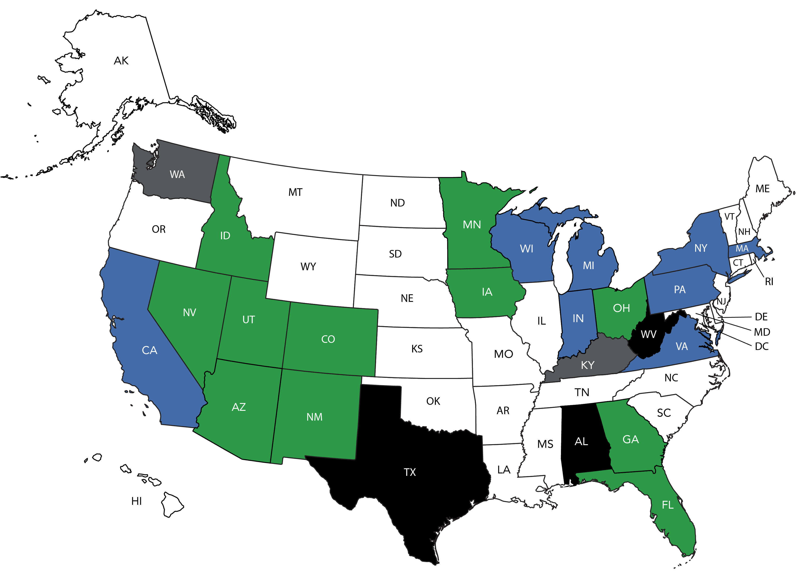
Plumbing Engineering Option Within the Mechanical Engineering Exam
State License Board contacted – need additional letters of support.
Initiative approved by State License Board.
Letters of support need to be sent to State License Board.
Face to face meeting – decision pending.
Face to face scheduled – pending rescheduled date.

Slide 83
ASPE Marketing

Slide 84
Marketing Update
ASPE Pipeline aspe.org/pipeline
We continue to post industry news daily, including updates from our Affiliate Sponsors and industry partners.
Original articles from our members and Affiliate Sponsors are contributed monthly.
Our Twitter handle, @aspepipeline, continues to see activity.
If you are interested in contributing an original article to ASPE Pipeline, please contact gpienta@aspe.org.
Chapter Officers: We’d love to help you publicize your Chapter’s activities on ASPE Pipeline. Please send relevant details and photos to gpienta@aspe.org.
Membership Recruitment
We are conceptualizing a new membership marketing campaign targeting engineers specializing in areas other than plumbing: HVAC/R, fire protection, medical, etc.

Slide 85
Marketing Update
New Brochures
How to Start a WOA Group in Your Area
Invest in Your Career with ASPE
Marketing Materials for Chapters
You can find all of our current marketing materials in the Chapter Officers Resource Center on aspe.org.
Just click on Chapter Officers under the Membership & Global Community menu.
Logos and flyers for the 2022 ASPE Convention & Expo were recently added for your use in advertising the event in your newsletter/website.
The Value of ASPE PowerPoint was recently updated, so be sure to download the new version.
For help with designing Chapter event marketing materials, contact nsaucedo@aspe.org.
Women of ASPE
WOA now has a LinkedIn page: linkedin.com/showcase/women-of-aspe
We started a monthly social media campaign for WOA themed “Did you know…”

Slide 86
Marketing Update
Member Eblasts
A series of monthly eblasts has been created to welcome new members and help them make the most of their membership.
  The “Welcome to ASPE” eblast includes information on and links to member resources and benefits such as our websites, ASPE Connect, the Plumbing Engineering Design Handbooks, national events, special-interest groups, and more.
  The ”Get Connected” eblast explains how to use ASPE Connect to ask questions, share knowledge, make connections, and download the mobile app.
  Eblasts to be developed will cover ASPE.org, ASPE Pipeline/social media, and Mentor Match.
A “We Miss You” eblast is sent to dropped members at the beginning of each month to remind them of ASPE’s member benefits and encourage them to rejoin.
We also developed an eblast to send to Chapter Officers at the beginning of each fiscal year that explains some of the resources available on our website and who to contact with questions.

Slide 87





Marketing Update
ASPE Connect
We recently surpassed 1,000 unique contributors in ASPE Connect, a major milestone.
You now can access ASPE Connect on our new mobile app. Just download the Connected Community app in the Apple App Store or Google Play Store; enter the community's domain: connect.aspe.org; and login using your usual community credentials.
Social Media
Don’t forget to follow ASPE on social media to stay up to date on all of the latest Society news.
  linkedin.com/company/american-society-of-plumbing-engineers
  facebook.com/AmericanSocietyofPlumbingEngineers
  twitter.com/ASPEorg
  twitter.com/ASPEexpo
  instagram.com/aspe.org
  youtube.com/channel/UCJFy5ih4JvM9KDBE3EOglRw

Slide 88
ASPE Publications

Slide 89
Publications Update
Plumbing Engineering Design Handbook, Volume 1: The 2021-2022 edition of this handbook was distributed to members in good standing earlier this year.
Plumbing Engineering Design Handbook, Volume 2: Staff is working with the Technical & Research Committee and other contributors to revise the 2022-2023 edition.
Plumbineering Dictionary: The dictionary is now online as a free member benefit. You can find it in the members-only section of aspe.org.
ARCSA/ASPE 78: Stormwater Harvesting System Design: The Working Group finished revising the 2015 version of this standard, and it has gone through one public review/Main Design Standards Committee ballot.
WQA/ASPE S-802: Sustainable Water Treatment Media: The 2017 version of this standard was approved for reaffirmation by the Main Design Standards Committee, and we are working with ANSI to have it approved as an American National Standard.
Engineered Plumbing Design II: The project to revise this handbook has been restarted.

Slide 90
Publications Update (continued)
EditionGuard: To protect ASPE’s intellectual property, we are now using EditionGuard to deliver digital versions of our publications. Downloads are now eBooks rather than PDFs, which means they cannot be copied or shared.
PEDH Downloads: Due to the implementation of EditionGuard, you now download PEDH volumes via our bookstore instead of ASPE Education. You can find the links at aspe.org/publications-news/aspe-plumbing-engineering-design-handbooks.
Book of the Month: This member benefit program runs from March to December each year. It allows ASPE members to purchase one ASPE publication at a significant discount each month. Notification of the current Book of the Month is sent via eblast.
Chapter Officer Pricing: The Chapter Officer pricing option has been removed from the ASPE Bookstore. If a Chapter Officer needs to buy a book in bulk, they can contact gpienta@aspe.org for a coupon code to use to receive the Chapter Officer price. At least 10 copies of a single book must be purchased to use the coupon.

Slide 91

September 16-21 // Indianapolis

Slide 92
Updates
  Expo: September 19-20, 2022 // Convention: September 16-21
  Hotels: JW Marriott , Marriott, Westin, Hyatt, Crown Plaza
    All hotels connected to the Convention Center
  Indiana Convention Center – Halls A-D

Slide 93
Why Attend?
2022 ASPE Convention & Expo is the only event this year designed to enhance the professional development, technical education, and career growth of plumbing industry professionals—combining the largest tradeshow dedicated exclusively to plumbing system design products and services with a technical education program for professionals at all career levels.

Slide 94
What you will find:
The largest plumbing product showcase in the country filled with new technologies from more than 250+ global exhibitors
Technical solutions to your plumbing design challenges directly from product engineers
Game-changing innovations and hands-on application advice
New ways to save time and money through live sessions on the show floor
Networking events designed to connect you with thousands of industry professionals
25+ technical education sessions to help you learn new skills and advance your career
Opportunities to earn CEUs
Notes:
More reason to attend-

Slide 95
Updates
  Keynote Speaker : Chris Stricklin
    Chris “Elroy” Stricklin is co-author of Survivor’s Obligation: Navigating an Intentional Life. A retired Air Force Colonel and a combat-decorated fighter pilot, Chris will share his inspirational story on how he learned to heal and live more fully on a daily basis.
  Sunday Night Party Sponsored by NIBCO
      Crane Bay Events Center (walking distance to/from hotels but shuttle service will be provided)
  Society President VIP Event
    All Chapter Presidents are invited to this event on Saturday, September 17th from 7 P.M. – 9:00 P.M.
  American Rainwater Catchment System Association (ARCSA)
  ARCSA will hold their meeting at this year’s Expo from Monday, September 19 to Wednesday, September 21.
Notes:
Other reasons to attend as a Full Registration attendee :
Chris Stricklin will be our Keynote speaker. He will present on Monday morning at the Awards Ceremony (before we open the EXPO floor).
Sunday night party – the event to not miss. It our fun night kicking off the Expo . Live Music, food & drinks, a chance to meet other attendees. ASPE will provide a shuttle service from the hotels to Crane Bay Event Center.
All Chapter Presidents are invited to the Society President VIP Event. As of now, we have not confirmed a location to hold the event. Email Invitation to the event will be sent beginning in August. Please RSVP.
ARSCA will be at this year’s EXPO. ASPE has agree to help ARSCA in holding their meetings. They will not conflict with our events. A separate registration ( and fee) is required if you want to attend their event.

Slide 96
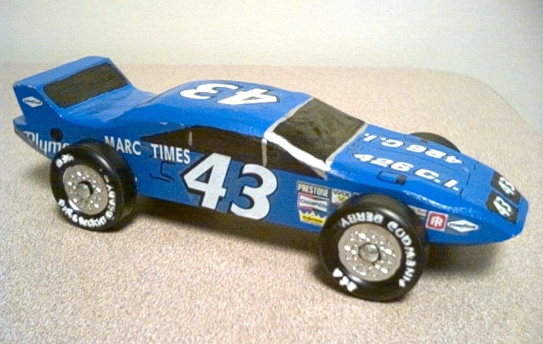
Updates
  New Badges. ASPE will no longer use badge holders. A majority of tradeshows use new badges that are simpler to print and environmentally friendly.
  Return of the Ribbon Wall. With success at the Tech Symposium in San Diego, ASPE again will have a ribbon wall near registration, where attendees can select the ribbons needed for their badge.
  Get the app! Keeping with environmentally friendly goals, this year’s app will serve as the Show Program Guide.
  Booth sales continues to grow, and our Expo show floor is almost sold out. We expect a great turnout at the 2022 Expo.
Notes:
ASPE will not use a badge holder this year. Those thick plastic holders that we insert the paper name cards.
Most trade shows have been using this style badge ( the one we are going to use) for the pass 4 years. Its environmentally friendly. You will be able to add ribbons and use lanyard. Will not tear or rip.
When checking into registration – we will have two location: the JW Marriott and Convention Center. JW Marriott will be open starting on Friday and be used for those attending the Business meeting. Convention registration which open on Sunday will be more for those who attend EXPO only.
ASPE will be using a Ribbon Wall again. Ribbon wall is where all the badges’ ribbons will be located for self selection. We tried it at Tech Symposium and attendees like it. Most trade show have been using ribbon walls for a long time. Easy access and you can select what you need.
ASPE will not print a program guide this year . All information that was normally included in the program will be on the Phone/ tablet app. Most trade show have stopped printing programs 5 to 6 years ago. ASPE was to implement the change in 2020.

Slide 97
What is ASPE Racing at INDY?
ASPE Racing at Indy is similar to a pinewood derby event of Scouts BSA. It will be a timed race in which each car will race four times once in each lane of the four-lane track, thus eliminating any lane advantage. The four race times will be totaled and averaged through a computerized timing system to provide an official race time for each car that will be used in determining awards and prizes.
The races will be on Tuesday, September 20th at 8:15 – 10:15 A.M.
Eastern Michigan Chapter members will serve as the pit crew for the event, and the Chapter’s VPL, William Grayzar, CPD, GPD, will serve as the Master of Ceremonies.
Notes:
An Email was sent to all Chapter officers informing them of the races and how to participate. Goal is to get all chapters submitting a car.
Awards for 1st , 2nd and 3rd overall and then the fastest in each Region.
Eastern Michigan Chapter is handling all detail of this event. Contact Bill Grayzar at bill@dsdonline.com for any details.
Car kits will be distributed at Region meeting.

Slide 98
www.expo.aspe.org
  Please visit our website. There is a lot of great information about the
  Conference & Expo. We continue to update the site daily.
Notes:
Encourage everyone to go the website. Staff will continue to update site with more and more information.

Slide 99
Future Events

Slide 100
Symposium / Convention & Expo
2023 Technical Symposium Bellevue, WA | September 28 - October 1
2024 Convention & Expo Columbus, OH | October 18-23
2025 Technical Symposium Orlando, FL | September 25-28
2026 Convention & Expo TBD
Notes:
Bellevue is just outside of Seattle. The host chapter is excited to host us in Northwest part of the country.
BOD recently approved the 2025 Tech Symposium to Orlando, Florida. The symposium will be held at Rosen Centre on I Drive close to the Orlando convention center. It a beautiful hotel, with lots to do in the area.

Slide 101

Affiliate Relations

Slide 102

ASPE Affiliate Programs
Affiliate Sponsor Program:
Continues to be an integral part of our Affiliate Program.
Staff continues to add to the benefits of being an Affiliate Sponsor.
  Sponsor profiles on aspe.org allow for additional information about our supporters, including video and social media links.
Delta Commercial continues to be the Exclusive Sponsor for the Women of ASPE.
Zurn continues to be the Exclusive Sponsor for ASPE Young Professionals.
Notes:
Delta Commercial – WOA Sponsoring webinars and the WOA Forum at Convention & Expo
Zurn – Will be hosting the AYP social event at Convention & Expo

Slide 103
ASPE Affiliate Programs
ASPE Pipeline:
  The ASPE Digital Footprint
  The place for ASPE News and technical information
  Several advertising opportunities continue to be available.
  Staff continues to work on format and layout
ASPE Convention & Expo:
  Sponsorship activity continues to be strong.
  Product Showcase and Innovation Theatre continue to be popular.
  NIBCO is the sponsor of the Sunday Night Party at the Crane Bay Event Center.
Notes:
ASPE Pipeline – we need to emphasize the need for members to visit Pipeline
We need the support of the manufacturers, so members need to spend a bit of time looking around

Slide 104
Thank You!

