Slide 1
American Society of Plumbing Engineers
2021 Region Meetings
Updates for Chapter Leaders from the Society’s Board of Directors

Slide 2
ASPE Staff
C. Reis
Managing Director / Director of Meetings
G. Pienta
Director of Communications & Publications
B. Henry
Director of Affiliate Relations & Education
R. Albrecht
Director of Information Technology
E. Gauchman
Sr. Manager of Finance & Administration
R. Mata
Sr. Director of Technical & Regulatory Affairs
R. Rodriquez
Membership Coordinator
N. Saucedo
Manager of Graphics & Website Design
L. Gonzalez
Chapter Education/ Registration Coordinator
N. O’Connor
Manager of Education & Certification
B. Smith, ,FASPE, Executive Director/CEO
L. Gonzalez Membership & Chapter Meeting Coordinator

Slide 3
ASPE Coronavirus (COVID-19) Preparedness Resources

Slide 4
ASPE’s Response to COVID-19
On March 19, ASPE President Carol Johnson and Executive Director/CEO Billy Smith sent a letter to Chapter Officers about not holding face-to-face meetings. Additionally, the Society recommends our Chapters should follow the recommendations and guidelines set forth by the CDC, local municipalities, and local Health Departments.
On March 20, ASPE Executive Director/CEO advised our Membership of Society operations to address the health and safety of our staff. In addition, ASPE launched a proactive COVID-19 Preparedness Resource page to help our members stay safe and productive wherever and however they were conducting business during this time. It can be found via this link: https://www.aspe.org/coronavirus-covid-19-preparedness-resources/.
On March 20, ASPE announced a new service to help Chapters conduct virtual meetings to maintain operations and help members obtain CEUs.
On April 7, ASPE sent a letter to Chapter Officers offering assistance if needed to address Chapter Elections for 2020.
On April 10, ASPE sent a letter to our Chapters informing them that all Region Meetings would be hosted by the respective Region Director in a virtual format.

Slide 5
ASPE’s Response to COVID-19
“CDC Resources:
https://www.cdc.gov/coronavirus/2019-ncov/index.html
https://www.cdc.gov/coronavirus/2019-ncov/community/organizations/businessesemployers.html
“Guidance from WHO (World Health Organization):
https://www.who.int/emergencies/diseases/novel-coronavirus-2019
“Thanks to each of you for your willingness to serve and steward our Society onward
and upward. Please know that we will continue to monitor the situation and work for
and with you during this time.”

Slide 6
Membership Initiatives

Slide 7
ASPE Compassion Waiver
ASPE hopes you and your family remain healthy and safe during these unprecedented times brought about by the COVID-19 pandemic.
ASPE is committed to helping our members maintain their professional success through the benefits of being and remaining an ASPE member. As a member, we are sure you are committed to the same goal.
Knowing how important our members are to the Society’s overall success, and especially now, knowing how the circumstances of this pandemic have affected the plumbing engineering industry as a whole, ASPE would like to share a reminder of the Compassion Waiver of Society Dues.
Should you have a need, please use this link to continue receiving the needed benefits of being an ASPE member: https://www.aspe.org/membership-global-community/membership/members-only/application-for-compassion-waiver-of-society-dues/

Slide 8
Multi-Year Membership Renewal
Program is available to new and current members.
Renew for two years to receive 5% off dues payment and pay $361.
Renew for three years to receive 10% off dues payment and pay $513.
To date, 272 participants are taking advantage of this initiative.
Notes:
Multi-Year Membership Renewal
There are 272 active members utilizing this multi-year discount.
Now you can save on your ASPE membership dues if you join or renew for more than one year. Current and new members will get a 5% discount for a two-year renewal and a 10% discount for a three-year renewal. Thus, members opting to join or renew for two years would pay $361 for both years, representing a $19 discount, and members opting to join or renew for three years would pay $513 for three years, representing a $66 discount.

Slide 9
Multiple Chapter Affiliation
Program is available to new and current members.
Home Chapter affiliation is the standard dues rate of $190.
Additional Chapter affiliations are $80 per Chapter.
No limit to the number of Chapters with which a member can affiliate.
Board participation is allowed for any Chapters with which the member is affiliated.
Participation as a Delegate is only allowed with the Home Chapter.
To date, 49 members have multiple Chapter affiliation.
Notes:
There are 49 active members with multiple Chapter affiliations.
The first Chapter affiliation is the standard dues of $190.
Additional Chapter affiliations are $80 per Chapter. There is no limit to the number of Chapters with which a member can affiliate.
The member must designate a Home Chapter.
Regardless of the Home Chapter affiliation, the member can serve on the Board of Directors for any Chapter with which the member is affiliated.
However, the member can only serve as a Convention Delegate for his/her Home Chapter.
Members affiliating with multiple Chapters will receive only one Plumbing Engineering Design Handbook (PEDH) per year when renewing.
Contact the Membership Department at 847-296-0002 for more information or to affiliate with multiple Chapters.

Slide 10
Early Renewal Discount for First-Year Members
Renew by the end of the eighth month of membership and receive a reduced dues amount of $170.
Only 125 members per quarter can take advantage of the offer.
Renewal must be done online at aspe.org/MembershipRenewal.
To date, 13 members have participated in this initiative.
Notes:
Early Renewal Discount for First-Year Members
Only 13 members have used this discount to date. All 13 were in 2019. This program has not been used since.
After you join ASPE for the first time, you can ensure continued membership benefits at a discount by renewing early. Any first-year member who renews by the end of the eighth month of their membership will receive a reduced dues amount of $170 for the second year, therefore saving $20 by renewing early.
Eligibility guidelines for this discount follow:
Only 125 members per quarter can take advantage of this offer.
Renewal must be done online at aspe.org/MembershipRenewal.
Questions regarding this program should be directed to membership@aspe.org.

Slide 11
Membership Services Update

Slide 12
End-of-Year Reporting System
Reporting system now mirrors the P&O Manual.
Various verbiage updated to be more concise.
Officer overview screen now has option to look at previous year.
An export to Excel is now available.

Slide 13
Renewals
Implementation of the online renewal has been completed.
Implementation of the redesigned hard copy renewal invoice has been completed.

Slide 14
Virtual Chapter Meetings
Notes:
Chapter meetings have been held virtually due to Covid-19 as of March 2020, the numbers below reflect this past quarter that staff has taken over since PRs departure in Dec 2020:
January 2021 held 31 meetings
February 2021 held 31 meetings
March 2021 held 35 meetings
January 2021 had 1 canceled meeting - Chicago
February 2021 had 1 canceled meeting - Seattle
March 2021 had 2 canceled meetings - Intermountain & Arkansas
From using an order date of 1/1/21 thru 3/31/2021:
$500 received from non member registrations in January
$650 received from non member registrations in February
$300 received from non member registrations in March
Meeting requests are scheduled weekly, sometimes daily depending on the amount of requests received.

Slide 15
ASPE Mentoring Program –
Now Available Through Connect.aspe.org

Slide 16
ASPE Mentoring Program
This program, which is available to all members of the Society, is designed to connect ASPE members who have a particular skill set (mentors) with individuals (mentees) who are searching to acquire the same skills to develop and make progress toward their personal and professional goals.
No set rules to being a Mentor/Mentee as you set your topic.
Mentor/Mentee set the tone and length of the relationship.
Mentor/Mentee decide when and how often to meet.
Notes:
Talking Points
There are no set rules to being a mentor/mentee.
Mentor/mentee set the tone of the relationship.
Decide how and when they want to meet.
Decide how often they want to meet.
Determine the length of the relationship.

Slide 17
ASPE Connect – Mentor Match
Members who wish to remain in the program have been crossed over to Mentor Match in connect.aspe.org.
Members are now able to search for their own Mentors based on criteria they need.
ASPE Staff manages the program, cleaning up matches and reporting.
Current Mentees – 35, with 2 of those not currently participating.
Current Mentors – 26, with 1 of those not currently participating.
3 matches have been completed and 0 matches are pending.
Currently, we have 15 active matches.
Notes:
Overall Participants in the Program
Mentees – 35, with 2 not currently participating
Mentors – 26, with 1 not currently participating
Active Matches – 15
Completed Matches – 3
Pending Matches - 0

Slide 18
Membership At A Glance

Slide 19
Membership Trend
Notes:
Membership trend over the past five years:
2016 – 6,008
2017 – 6,163
2018 – 6,347
2019 – 6,519
2020 – 6,332
2021 – 6134

Slide 20
Membership by Type
Notes:
2020-2021 comparison (based on March 31, 2021 numbers)
2020 (6,332) 2021 (6,134)
Affiliate 1,594 1547
Full 3,711 3,702
Associate 556 520
Governmental 51 50
Special 161 139
Retired 89 84
Student 37 43
Life 42 46

Slide 21
ASPE Young Professionals 35 & Under
Notes:
2019 – 1,361 Members
2020 – 1,102 Members (as of 03/31/2020)
2021 – 1,248 Members (as of 4/16/2021)
Full 502
Associate 436
Governmental 3
Special 13
Student 36
Affiliate 258

Slide 22

Reaching Out to the Younger Generations
Chapter AYP Liaisons are continuing to host events.
  There are currently 42 appointed liaisons. If your Chapter’s AYPL is not listed, the Society is not aware of your appointment (must be 35 years old or younger).
AYP Leadership Conference will be held at the 2021 Tech Symposium.
New! Guidelines for AYP roles within the Society and Chapters was developed.
Any questions, please contact the AYP Committee: ayp@aspe.org

Slide 23

Women of ASPE by Member Type
Notes:
Women of ASPE is gender neutral.
To become a part of Women of ASPE, one must opt-in.
You may select to be part of WOA while either applying for membership or renewing a current membership.
2019: 307 Members
2020: 263 Members (as of 3/31/20)
2021: 307 Members (as of 4/16/21)
Full – 179
Affiliate – 62
Associate – 54
Special – 6
Governmental – 1
Student – 4
Presidential – 1
Retired – 0

Slide 24
Sarah Balz, Chair
Carol Johnson (Society Board Liaison)
Racquel Rodriguez
(Staff Liaison)
Nadine Saucedo
(Staff Liaison)
REGION 4 LIAISONS
Linda S. Burman
(Seattle)
Linda Deunay
(Los Angeles)
REGION 5 LIAISONS
Natalia Dankanich (Chicago)
Ana Ginter (Central Texas)
Judith Torres (Chicago)
CHAPTER WOA LIAISONS
(optional for all regions)
REGION 3 LIAISON
Lee Marie Bocanegra (West Coast Florida)
Elvira Pita-Mejia
(South Florida)
REGION 2 LIAISONS
Theresa Lyn Allen (Michigan)
Gwynne Morrison (Buffalo-Niagara)
Terrese Tuchscher
(Cleveland)
REGION 1 LIAISONS
Illsa Liebler
(Capital Region NY)
Notes:
To contact the WOA committee, visit https://www.aspe.org/membership-global-community/membership/special-interest-groups/women-of-aspe/.

Slide 25
Women of ASPE
MEMBERSHIP STANDINGS
2021 ACTIVITIES:
WOA Webinars
WOA Chapter Events
WOA Half-Day Educational Events
WOA Scholarship for 2021 Symposium
Notes:
Women membership growth trend since the inception of WOA:
2015 – 431
2016 – 449
2017 – 465
2018 – 521
2019 – 611
2020 – 604 (as of 3/31/20)
2021 – 590 (as of 4/16/21)
Over the past six years, the number of women in the Society has increased from 431 members to 590, representing a 37% increase in membership.

Slide 26
Women of ASPE
CHAPTER PRESIDENTS
CHAPTER OFFICERS
Notes:
Chapter Presidents:
2015 – 3
2016 – 3
2017 – 10
2018 – 8
2019 – 10
2020 – 10 (as of 3/31/20)
2021 – 10 (as of 4/16/21)
Chapter Officers:
2015 – 54
2016 – 49
2017 – 71
2018 – 67
2019 – 75
2020 – 81
2021 – 113 (Represents the highest number of women to date serving in leadership roles on the chapter level.)

Slide 27
ASPE Life Members 2020-2021
David Maghen // Los Angeles Chapter
Jeffrey Ingertson CPD // Phoenix Chapter
Vivian Enriquez CPD, FASPE // Los Angeles Chapter
Kook Dean P.E. // Los Angeles Chapter
Wilson Soo Hoo CPD // Los Angeles Chapter
Milton Burgess P.E., FASPE // San Diego Chapter
Michael Olson CPD, GPD, FASPE // Phoenix Chapter
Earl Boulware P.E., MBA // Central Indiana Chapter
Ronald Bradford // Los Angeles Chapter
David DeBord CPD, GPD, LEED AP BD+C // Chicago Chapter
Everett Crowdis // British Columbia Chapter
John Lee // Phoenix Chapter

Slide 28
2023 ASPE Chapter Leadership Summit Proposal
The Westin O’Hare Hotel & Resort | 6100 N. River Road, Rosemont, IL 60018
June 23 – 25, 2023

Slide 29
2023 ASPE Chapter Leadership Summit
The American Society of Plumbing Engineers has 61 Chapters and 3 Satellites, each led by a volunteer leadership board. Over 600+ engineering professionals make up the volunteer Chapter leader community and are dedicated to the success of their Chapter.
For 2023, the meeting will be called the ASPE Chapter Leadership Summit.
Only one meeting will be held, in conjunction with the Society Board of Directors 3rd Quarter meeting in Chicago.
As typical, Chapter leaders will still be responsible for their air and hotel accommodations for the event.
Society will cover A/V expenses, food & beverage, and any other expenses accrued.
For 2023, the Chapter will not receive the $1,000 stipend that is typically given to help each Region offset the costs of hosting the meeting.

Slide 30
2023 ASPE Chapter Leadership Summit
Advantages to the Society
  Having one meeting will allow attendees to receive a uniformed and concise message surrounding national’s activities, allows for a better networking opportunity among Chapter leaders across all Regions, and provides the Society Board and staff the chance to interact with local leaders who are instrumental in carrying out the vision, goals, and objectives of the Society.

Slide 31
2023 ASPE Chapter Leadership Summit
Advantages to a prospective hosting Chapter:
  Will not have to find a location to host the Region meeting.
  Will not have to have a fundraiser to host the Region meeting.
  Will not have to negotiate for food and beverage at host location.
  Will not have to find a Saturday night dinner venue.

Slide 32
2023 ASPE Chapter Leadership Summit
Advantages of participation by attendees:
  Will have the benefit of the Society BOD and staff onsite to answer questions.
  Will have the opportunity to develop a better working relationship with the BOD and staff.
  May be an incentive for future Chapter Board Officers to volunteer.
  Will give attendees the opportunity to visit the Society office and learn more about staff responsibilities.
  Improved interaction of all attendees as you are captive in one location for the allotted time.

Slide 33
2023 ASPE Chapter Leadership Summit Schedule
DAY/TIME | EVENT | LOCATION
Thursday, June 22 | 12:00-5:00pm | Board of Directors Meeting | Division Meeting Room
Friday, June 23 | 8:00am-5:00pm | Board of Directors Meeting | Division Meeting Room
Friday, June 23 | 8:00am-3:00pm | ASPE Office Tour (open to chapter leaders and hosted by ASPE Staff- throughout the day) | ASPE Office
Friday, June 23 | 7:00-8:00pm | Chapter Leadership Conference Welcome Reception | ASPE Office or TBD
Saturday, June 24 | 8:00am-12:00pm | Society Board Presentation to Chapter Leaders | Executive Forum Amphitheater
Saturday, June 24 | 1:00pm-5:00pm | Region 1 Meeting Region 2 Meeting Region 3 Meeting Region 4 Meeting Region 5 Meeting | LaSalle A Meeting Room Madison Meeting Room Dearborn Meeting Room Division Meeting Room Higgins Meeting Room
Saturday, June 24 | 6:00-8:00pm | Chapter Leaders Dinner | LaSalle B/C Meeting Room
Sunday, June 25 | 8:00am-12:00pm | Chapter Leadership Closing Event | Executive Forum Amphitheater

Slide 34
Chapter Liability Concerns
Notes:
We continually to look for areas to fine-tune our operations daily to to assist in our financial feasibility, and all Chapters should do the same.
We sent a letter to all Chapters about fraud email issues and how to ensure that each Chapter can avoid issues in the future.
Take special precaution as to being diligent in focusing on emails requesting any amount of money to be forwarded at any time.

Slide 35
Fraudulent Emails
The Society has provided a letter for all Chapters about fraudulent email issues and how to ensure that each Chapter can avoid these types of issues in the future, which you can find on the Region Meetings webpage.
Take special precaution as to being diligent in verbally discussing and focusing on all emails requesting any amount of funds to be forwarded at any time or reason.
Notes:
Please be aware that within the Region Meetings webpage, the Society has provided a copy of this letter for your files and future use.

Slide 36
Copyright Infringement
The Society has provided a letter for all Chapters about copyright infringement issues and how to ensure that each Chapter can avoid these types of issues in the future, which you can find on the Region Meetings webpage.
Take special precaution and be diligent in discussing and distributing any emails, documents, and photographs that are the property of others.
This can turn out to be a very expensive lapse in judgement.
Notes:
Please be aware that within the Region Meetings webpage, the Society has provided a copy of this letter for your files and future use.
This can be explored in more detail by visiting the Region Meetings webpage and clicking on the information provided relative to Chapter Liability Concerns.

Slide 37
Website Security and Maintenance
One of the largest concerns today is the hacking of websites to gain valuable information, both professional and personal.
Each of our Chapters should take necessary precautions to ensure protection, with the understanding that nothing is absolute as to protection.
Following is a list of steps each respective Chapter and Officer could consider for proper protective measures. Some may be cost prohibitive, but all are worth review.
Notes:
This can be explored in more detail by visiting the Region Meetings webpage and clicking on the information provided relative to Chapter Liability Concerns.

Slide 38
Website Security and Maintenance
More information on the following tips can be found on the Region Meetings webpage under Chapter Liability Concerns.
Use strong passwords – both for
the Chapter and personally.
Install an SSL certificate.
Use a secure host.
Install a web application firewall.
Regularly scan your site for malware.
Back up your site.
Set up a login lockdown feature.
If possible, enable 2FA.
Disable directory indexing and browsing.
Protect the admin directory.
Continuously monitor and test your site.
Notes:
This list of items can be explored in more detail by visiting the Region Meetings webpage and clicking on the information provided relative to Chapter Liability Concerns.

Slide 39
Chapter Officer Personal Protection
For each ASPE member who volunteers to serve as a Chapter Officer, the Chapter needs to provide a way to contact them on the Chapter website.
One of the most proven methods of being proactive in personal information protection is to establish a contact email that is not in any way connected to your personal files or contact information.
A suggestion to be strongly considered is to establish something like a specific Gmail account for your volunteer contacts.

Slide 40
ASPE Connect

Slide 41
ASPE Connect
Make sure you have found this link: connect.aspe.org
ASPE’s newest member benefit launched March 2019.
It is an online community to connect, engage, and learn.
Members can network, share insights and experiences, and gain knowledge from professionals around the world.
Who here has logged in and started discussing?
There is availability for more Chapter and committee communities as requested to fulfill a need.
Review the “All Communities” tab to find the established communities for committees and Chapters.
These communities are a tremendous benefit and resource for our members.
We now are offering a free 30-day trial of Connect to nonmembers.
Notes:
Notes:
A reminder to all our Connect members is to market the benefits and resources made available to our members by logging in and participating.
Of interest, under the “All Communities” tab, you can find all of the different communities that are currently available to our registered members.
We have topic-specific communities, we have communities based around our ASPE committees, and we have communities just for ASPE Chapters.
Should you see a need for other communities, please contact ASPE Staff for getting a needed community developed for our members’ use.
A prime example of a committee community that has been a high-quality benefit to our members and the Society is the Legislative Community, which has been using the tools made available through Connect to stay on top of the industry’s important legislative, regulatory, and advocacy needs around the country—a valuable use of this collaborative membership benefit and resource tool.

Slide 42
ASPE Connect Stats and Usage
54% of ASPE Members have logged into ASPE Connect at least once since its inception.
  Benchmark is 20% in the first 90 days and 5% year-over-year growth. ASPE Connect is well above this industry benchmark.
Average reply per thread is 4.8.
  Industry standard is an average of 2 replies per thread.

Slide 43
ASPE Connect Stats and Usage
We have 577 unique contributors to ASPE Connect, which is 8.5% of members who have posted at least once.
  When we look at the 90 – 9 – 1 rule, 90% are lurkers, 10% are passively engaged, and 1% are creators. ASPE has a very healthy number of members who are posting.
  Remember, just because a member does not actively post does not mean they are not receiving value out of consuming the community content.
Average digest open rate is 20.8%.
  Benchmark is 18-20%. ASPE is on the high end of the healthy range.
Unsubscribe percentage is 10.1%.
  Benchmark is to remain below 15%.

Slide 44
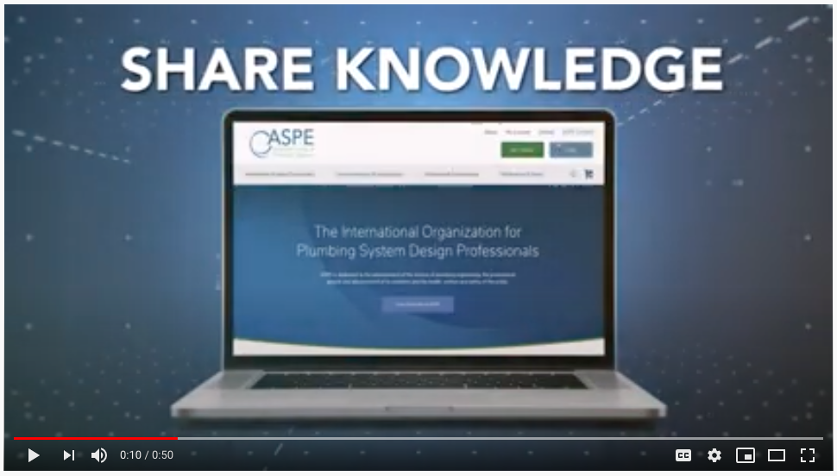
ASPE Connect Promotional Video + Anniversary
youtu.be/9Y76txSdFqk

Slide 45
ASPE Education

Slide 46
Education – Webinars
10 Webinars were offered to ASPE members and non-members in ‘20 & ‘21
Majority of webinars have been offered free to ASPE members
All webinars can be found by ASPE members in the ASPE Education webpage
at the following link: https://education.aspe.org/

Slide 47
Chapter Meeting CEU Integration with
ASPE Education
44 Chapters have submitted meetings to have attendance CEUs integrated with ASPE Education.
Allows meeting attendees to retrieve CEU certificate automatically in education.aspe.org.
We strongly encourage Chapters to use this tool.
CEUs stay with the person even if they switch jobs or email addresses.

Slide 48
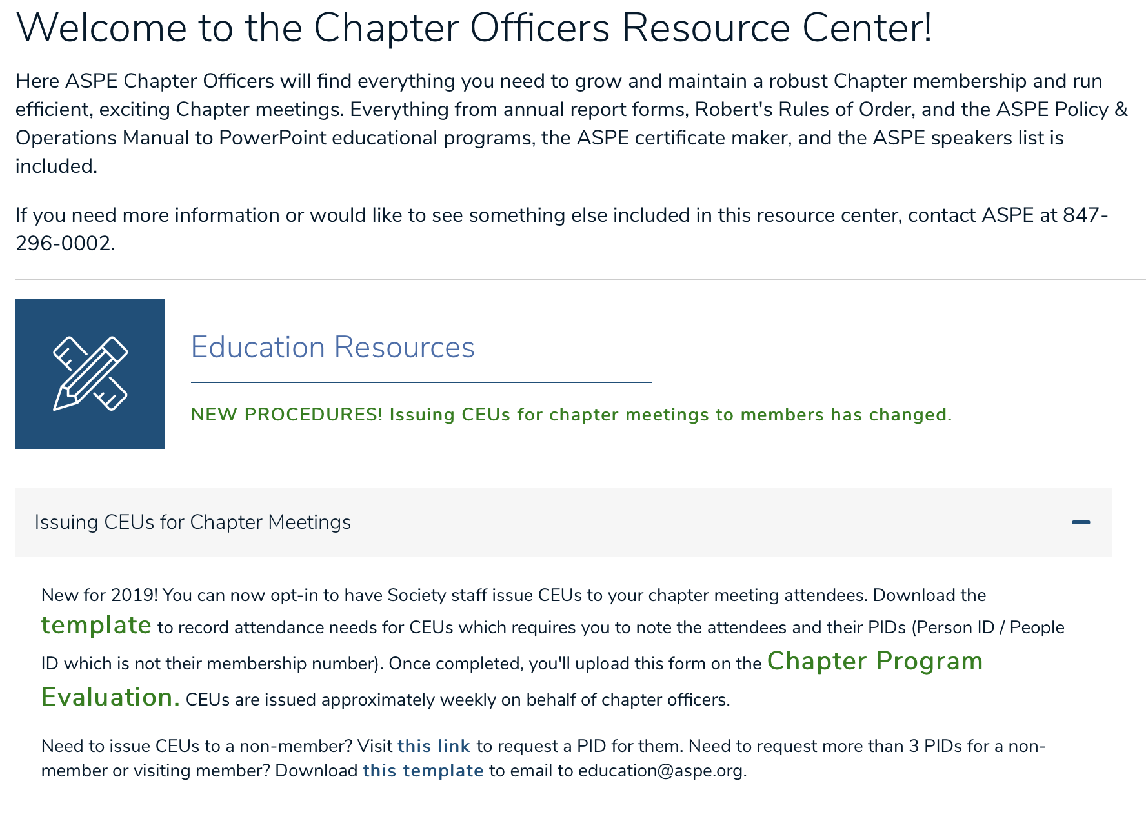
Notes:
Reminder: This is available on the ASPE website.
Located in the Chapter Officers > Education Resources section. Must be logged in to view this.

Slide 49
Chapter Meeting Integration During
COVID-19 Pandemic
Chapters have/had the ability to work with staff to integrate their monthly meetings with ASPE Education.
Allows for virtual participation and automatic application into attendee's education dashboard.
  No extra work for CEU reporting to have certificates issued.

Slide 50
Education – 2020 Digital Experience
  11 Total Sessions
  4 Networking Sessions
  Sessions to be re-released May 2021
    Member Cost - $70 per session
    Non-Member Cost - $100
    All Sessions can be used for CEU’s
  Free to ASPE Members Timeframe
    Sessions were available through January 31, 2021
    Total of 684 Members Registered

Slide 51

Outreach to the Younger Generation
In 2017 the Education Committee compiled a packet of information for Chapters to use for school or youth
outreach events (STEM or STEAM, scouts).
  One packet for K-5, another for grades 6-12
More projects are forthcoming.
Notes:
Reminder: This is available on the ASPE website.
Located in the Chapter Officers > Education Resources section. Must be logged in to view this.

Slide 52
Credentialing & Certification

Slide 53

Certified in Plumbing Design (CPD)
Currently there are 1,174 CPDs.
2021 CPD Revies Class 1 held February 13, 14 & 20
2021 CPD Review Class 2 held February 27, 28 & March 6
2021 CPD Exam was held April 5 through 18 – 112 candidates took the April exam
ASPE is considering the possibility of a second delivery of the exam in Q3/Q4 2021
CPD Review Webinar Series is on education.aspe.org.

Slide 54

Certified Plumbing Design Technician (CPDT)
Currently there are 122 CPDTs.
2021 Exam
  Exam dates are October 11 -22, 2021.
  Exam registration opens June, 2021.

Slide 55
CPD and CPDT Recertification
Recertification is now fulfilled on education.aspe.org.

Slide 56
Green Plumbing Design (GPD)
There are 172 current GPD certificate holders.
The current instructor, Mr. Doug Nelson, is working to transition the program entirely online.
This will allow candidates from al lover the world to participate and earn the GPD.
It is estimated that the course will be available and marketed to members prior to the 2021 Tech Symposium.

Slide 57
PE Working Group Update (PEWG)

Slide 58
PE Working Group Update (PEWG)
The WG has been extremely successful as it continues pursuing State PE Board approvals of ASPE’s initiative of working to develop a plumbing option within the framework of the Mechanical Engineering Principals and Practice of Engineering Examination.
The NCEES requirement is to gain the acceptance and support from (10) State PE Boards to move forward with the process.
Currently, the WG has gained approvals from the following (11) states. Georgia, Florida, Ohio, Arizona, Iowa, Idaho, New Mexico, Colorado, Nevada, Utah, Minnesota.
Our work follows the guidelines as administered by NCEES (National Council of Examiners for Engineering and Surveying).
Goals remain the same: ONLY for the inclusion of a plumbing option within the mechanical exam and NOT pursuing the development of a stand-alone discipline of Plumbing Engineering, like Civil, Electrical, Fire Protection, or Mechanical Engineering.

Slide 59
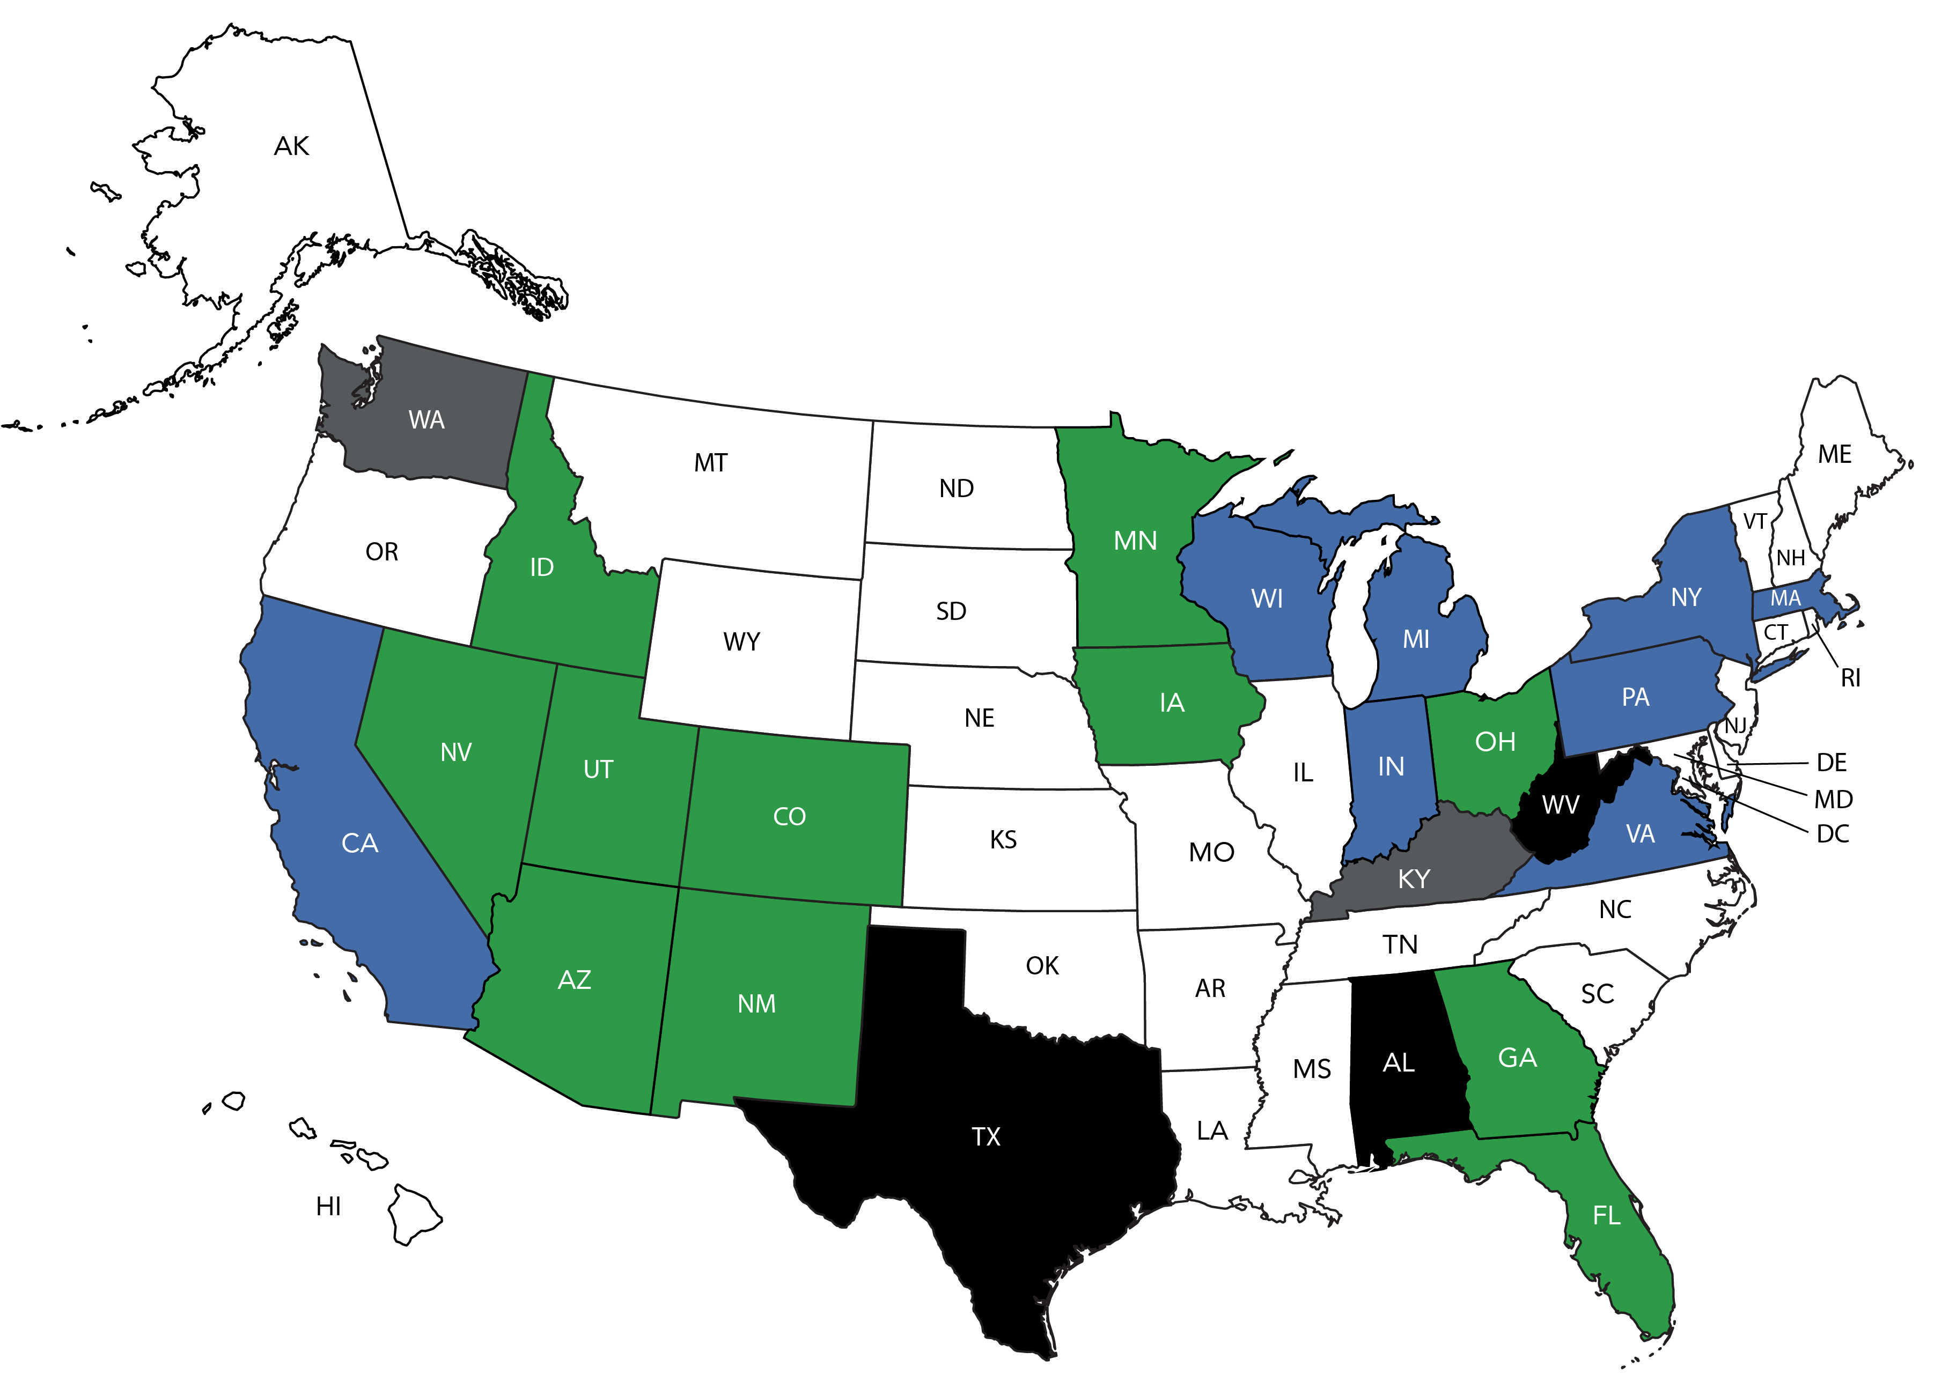
Plumbing Engineering Option Within the Mechanical Engineering Exam
State License Board contacted – need additional letters of support.
Initiative approved by State License Board.
Letters of support need to be sent to State License Board.
Face to face meeting – decision pending.
Face to face scheduled – pending rescheduled date.

Slide 60
ASPE Marketing

Slide 61
Marketing Update
ASPE Pipeline (aspe.org/pipeline)
Regular features that were previously found in the ASPE Report in Plumbing Engineer magazine are now on ASPE Pipeline: “From the President’s Pen,” “From the Executive’s Desk,” and New Members.
A monthly column, “Professional Engineer’s Perspective,” is being contributed by David Dexter, FNSPE, FASPE, CPD, CPI, LEED BD+C, PE, and debuted in January 2021.
A new regular feature, “Current Connection,” debuted in March 2021. It highlights expert advice from a popular thread on ASPE Connect and encourages readers to get involved in the discussion.
A new semi-regular column, “Engineer’s Notebook,” debuted in April 2021 and was written by John Lansing, CPD, LEED Green Associate, of the Portland Chapter.
Original Pipeline Exclusive articles are being contributed monthly by some of our Affiliate Sponsors.

Slide 62

Marketing Update
ASPE Pipeline (continued)
All videos have been put in a Featured Videos section and currently can be accessed via a banner ad on the homepage.
A search function was added to the top menu.
When applicable, tags are added to articles so users can easily find other articles on the same topics.
Our new Twitter handle, @aspepipeline, has 36 followers.
Road to San Diego Membership Drive
Our 2021 Chapter membership drive started March 1 and will end July 31. Chapters have the chance to win a free registration and hotel room to the 2021 ASPE Tech Symposium by encouraging both members and nonmembers to participate in ASPE Connect. The rules can be found in the Chapter Officers Resource Center on aspe.org. As of XX, the XX Chapter was in the lead, followed by XX.

Slide 63
Marketing Update
New Member Touchpoint
A new member touchpoint eblast is being sent monthly to those who joined two months prior. This infographic explains all of ASPE’s websites and ways to get involved for new members.
Engineers Week Social Media Campaign
During the 2021 Engineers Week, we ran a social media campaign to raise awareness of plumbing engineering as a profession. It included the following marketing pieces: “What Is a Plumbing Engineer?” infographic, “What Is ASPE?” infographic, “Who Is ASPE?” infographic, “Kickstart Your Career” video, and “Join ASPE.”
aspe.org
We added Canada to our region map, https://www.aspe.org/membership-global-community/chapters/, which went live on January 1, 2021.

Slide 64





Marketing Update
Marketing Materials for Chapters
You can find all of our current marketing materials in the Chapter Officers Resource Center on aspe.org.
For help with designing Chapter event flyers, contact nsaucedo@aspe.org.
Social Media
Don’t forget to follow ASPE on social media to stay up to date on all of the latest Society news.
  linkedin.com/company/american-society-of-plumbing-engineers
  facebook.com/AmericanSocietyofPlumbingEngineers
  twitter.com/ASPEorg
  twitter.com/ASPEexpo
  instagram.com/aspe.org
  youtube.com/channel/UCJFy5ih4JvM9KDBE3EOglRw

Slide 65
ASPE Publications

Slide 66
Publications Update
Plumbing Engineering Design Handbook, Volume 4: The 2020-2021 edition of this handbook was distributed to members in good standing earlier this year. We once again thank Paul Baker, PE, CPD, GPD, of the Dallas/Ft. Worth Chapter for serving as Technical Editor.
Plumbing Engineering Design Handbook, Volume 1: The Technical & Research Committee completed their pre-review of this handbook, and staff reached out to past contributors to help with the 2021-2022 edition. Staff is currently entering the edits and laying out the book.
Legionella Prevention Design Guideline: The Working Group has finished drafting this guideline and is seeking public comment.
ARCSA/ASPE 78: Stormwater Harvesting System Design: A Working Group was formed to revise the 2015 version of this standard.
CPD Study Guide: The CPD Review Manual was renamed the CPD Study Guide and is available for purchase in ASPE’s Bookstore.

Slide 67
Publications Update
Plumbing Technology and Practical Plumbing Engineering: These two books were removed from the ASPE Bookstore due to their age and outdated information. Staff is looking into ways to revamp the usable information. If a member needs a PDF copy of either book, please contact staff.
Book of the Month: This member benefit program runs from March to December each year. It allows ASPE members to purchase one ASPE publication at a significant discount each month. Notification of the current Book of the Month is sent via eblast.
Chapter Officer Pricing: The Chapter Officer pricing option has been removed from the ASPE Bookstore. If a Chapter Officer needs to buy a book in bulk, they can contact staff for a coupon code to use to receive the Chapter Officer price. At least 10 copies of a single book must be purchased to use the coupon.

Slide 68

Updates
September 21-26 // San Diego Marriott Mission Valley

Slide 69
Updates

Slide 70
Future Events

Slide 71
Symposium / Convention & Expo
2021 Technical Symposium San Diego | September 21-26, 2021
2022 Convention & Expo Indianapolis | September 16-21, 2022
2023 Technical Symposium Bellevue, WA | September 26 - October 2, 2023
2024 Convention & Expo Columbus, OH | October 15-24, 2024

Slide 72
Affiliate Relations

Slide 73

ASPE Affiliate Programs
Sponsor Program:
Continues to be an integral part of our Affiliate Program.
Staff continues to add to the benefits of being an Affiliate Sponsor.
  Sponsor profiles on aspe.org allow for additional information about our supporters, including video and social media links.
Delta Faucet continues to be the Exclusive Sponsor for the Women of ASPE.
Zurn continues to be the Exclusive Sponsor for ASPE Young Professionals.

Slide 74


ASPE Affiliate Programs
ASPE Pipeline:
New website format was introduced in late 2019.
  Continued expansion of ASPE Pipeline will be forthcoming.
Several advertising opportunities continue to be available.
ASPE Convention & Expo:
Sponsorship activity continues to be strong.
Product Showcase and Innovation Theatre continue to be popular.
Bradley Corporation is the sponsor of the Sunday Night Party at the House of Blues.
QuantumFlo will sponsor the Presidential Delegate and VIP Social – a new event!

Slide 75
Thank You!

