Slide 1
American Society of Plumbing Engineers
2020 Region Meetings
Updates for Chapter Leaders from the Society’s Board of Directors

Slide 2
ASPE Staff
B. Smith, FASPE
Executive Director/CEO
G. Pienta
Director Publications & Standards
B. Henry
Director Affiliate Relations
R. Albrecht
Director Information Technology
E. Gauchman
Finance & Administration Manager
R. Mata
Sr. Director Technical & Regulatory Affairs
P. Rosenberg
Director Education & Certification
M. Ali
Accountant
R. Rodriguez
Membership Coordinator
L. Gonzales
Membership Coordinator
N. Saucedo
Graphic Designer
C. Reis
Director of Meetings

Slide 3
ASPE Coronavirus (COVID-19) Preparedness Resources

Slide 4
ASPE’s Response to COVID-19
On March 19, ASPE President Carol Johnson and Executive Director/CEO Billy Smith sent a letter to Chapter Officers about not holding face-to-face meetings. Additionally, the Society recommends our Chapters should follow the recommendations and guidelines set forth by the CDC, local municipalities, and local Health Departments.
On March 20, ASPE Executive Director/CEO advised our Membership of Society operations to address the health and safety of our staff. In addition, ASPE launched a proactive COVID-19 Preparedness Resource page to help our members stay safe and productive wherever and however they were conducting business during this time. It can be found via this link: https://www.aspe.org/coronavirus-covid-19-preparedness-resources/.

Slide 5
ASPE’s Response to COVID-19
On March 20, ASPE announced a new service to help Chapters conduct virtual meetings to maintain operations and help members obtain CEUs.
On April 7, ASPE sent a letter to Chapter Officers offering assistance if needed to address Chapter Elections for 2020.
On April 10, ASPE sent a letter to our Chapters informing that all Region Meetings would be hosted by the respective Region Director in a virtual format.

Slide 6
ASPE’s Response to COVID-19
“CDC Resources:
https://www.cdc.gov/coronavirus/2019-ncov/index.html
https://www.cdc.gov/coronavirus/2019-ncov/community/organizations/businessesemployers.html
“Guidance from WHO (World Health Organization):
https://www.who.int/emergencies/diseases/novel-coronavirus-2019
“Thanks to each of you for your willingness to serve and steward our Society onward
and upward. Please know that we will continue to monitor the situation and work for
and with you during this time.”

Slide 7
Membership Initiatives

Slide 8
ASPE Compassion Waiver
ASPE hopes you and your family remain healthy and safe during these unprecedented times brought about by the COVID-19 pandemic.
ASPE is committed to helping our members maintain their professional success through the benefits of being and remaining an ASPE member. As a member, we are sure you are committed to the same goal.
Knowing how important our members are to the Society’s overall success, and especially now, knowing how the circumstances of this pandemic have affected the plumbing engineering industry as a whole, ASPE would like to share a reminder of the Compassion Waiver of Society Dues.
Should you have a need, please use this link to continue receiving the needed benefits of being an ASPE member: https://www.aspe.org/membership-global-community/membership/members-only/application-for-compassion-waiver-of-society-dues/

Slide 9
Early Renewal Discount for First-Year Members
Renew by the end of the eighth month of membership and receive a reduced dues amount of $170.
Only 125 members per quarter can take advantage of the offer.
Renewal must be done online at aspe.org/MembershipRenewal.
To date, 13 members have participated in this initiative.

Slide 10
Multi-Year Membership Renewal
Program is available to new and current members.
Renew for two years to receive 5% off dues payment and pay $361.
Renew for three years to receive 10% off dues payment and pay $513.
To date, 132 participants are taking advantage of this initiative.

Slide 11
Multiple Chapter Affiliation
Program is available to new and current members.
Home Chapter affiliation is the standard dues rate of $190.
Additional Chapter affiliations are $80 per Chapter.
No limit to the number of Chapters with which a member can affiliate.
Board participation is allowed for any Chapters with which the member is affiliated.
Participation as a Delegate is only allowed with the Home Chapter.
To date, 45 members have multiple Chapter affiliation.

Slide 12
Membership Services Update

Slide 13
End-of-Year Reporting System
Reporting system now mirrors the P&O Manual.
Various verbiage updated to be more concise.
Officer overview screen now has option to look at previous year.
An export to Excel is now available.

Slide 14
Renewal Invoice – (Hard Copy)
Implementation of the online renewal has been completed.
An in-process redesign of the hard copy invoice will include all of the membership initiatives.

Slide 15
ASPE Mentoring Program –
Now Available Through connect.aspe.org

Slide 16
ASPE Mentoring Program
This program, which is available to all members of the Society, is designed to connect ASPE members who have a particular skill set (mentors) with individuals (mentees) who are searching to acquire the same skills to develop and make progress toward their personal and professional goals.
No set rules to being a Mentor/Mentee as you set your topic.
Mentor/Mentee set the tone and length of the relationship.
Mentor/Mentee decide when and how often to meet.

Slide 17
ASPE Connect – Mentor Match
Members who wish to remain in the program have been crossed over to Mentor Match in connect.aspe.org.
Members are now able to search for their own Mentors based on criteria they need.
ASPE Staff manages the program, cleaning up matches and reporting.
Current Mentees – 20, with 2 of those not currently participating.
Current Mentors – 17, with 1 of those not currently participating.
3 matches have been completed and 5 matches are pending.
Currently, we have 7 active matches.

Slide 18
Membership At A Glance

Slide 19
Membership Trend

Slide 20
Membership by Type

Slide 21
ASPE Young Professionals 35 & Under

Slide 22

Reaching Out to the Younger Generations
Chapter AYP Liaisons are continuing to host events.
  There are currently 42 appointed liaisons. If your Chapter’s AYPL is not listed, the Society is not aware of your appointment (must be 35 years old or younger).
AYP Leadership Conference was held at the 2019 Tech Symposium.
At the 2020 Convention, a trivia night social will be sponsored by Zurn.
New! Guidelines for AYP roles within the Society and Chapters was developed.

Slide 23

Women of ASPE by Type

Slide 24
Sarah Balz, Chair
Carol Johnson (Society Board Liaison)
Racquel Rodriguez
(Staff Liaison)
REGION 2 LIAISONS
Theresa Lyn Allen (Michigan)
Gwynne Morrison (Buffalo-Niagara)
REGION 3 LIAISON
Lee Marie Bocanegra (West Coast Florida)
REGION 4 LIAISONS
Linda S. Burman
(Seattle) Carmen Gonzalez (Los Angeles)
REGION 5 LIAISONS
Natalia Dankanich (Chicago)
Ana Ginter (Central Texas)
Judith Torres (Chicago)
CHAPTER WOA LIAISONS
(optional for all regions)
REGION 1 LIAISONS
Ilsa Liebler (Capital Region NY)

Slide 25
Women of ASPE
MEMBERSHIP STANDINGS
2020 ACTIVITIES:
2020 WOA Forum
2020 WOA Convention & Expo Scholarship
WOA Chapter Events
Half-Day Educational Events

Slide 26
Women of ASPE
CHAPTER PRESIDENTS
CHAPTER OFFICERS

Slide 27
2021 ASPE Chapter Leadership Summit Proposal
The Westin O’Hare Hotel & Resort | 6100 N. River Road, Rosemont, IL 60018
June 24 – 27, 2021

Slide 28
2021 ASPE Chapter Leadership Summit
The American Society of Plumbing Engineers has 61 Chapters and 3 Satellites, each led by a volunteer leadership board. Over 600+ engineering professionals make up the volunteer Chapter leader community and are dedicated to the success of their Chapter.
For 2021, the meeting will be called the ASPE Chapter Leadership Summit.
Only one meeting will be held, in conjunction with the Society Board of Directors 3rd Quarter meeting in Chicago.
As typical, Chapter leaders will still be responsible for their air and hotel accommodations for the event.
Society will cover A/V expenses, food & beverage, and any other expenses accrued.
For 2021, the Chapter will not receive the $1,000 stipend that is typically given to help each Region offset the costs of hosting the meeting.

Slide 29
2021 ASPE Chapter Leadership Summit
Advantages to the Society
  Having one meeting will allow attendees to receive a uniformed and concise message surrounding national’s activities, allows for a better networking opportunity among Chapter leaders across all Regions, and provides the Society Board and staff the chance to interact with local leaders who are instrumental in carrying out the vision, goals, and objectives of the Society.

Slide 30
2021 ASPE Chapter Leadership Summit
Advantages to a prospective hosting Chapter:
  Will not have to find a location to host the Region meeting.
  Will not have to have a fundraiser to host the Region meeting.
  Will not have to negotiate for food and beverage at host location.
  Will not have to find a Saturday night dinner venue.

Slide 31
2021 ASPE Chapter Leadership Summit
Advantages of participation by attendees:
  Will have the benefit of the Society BOD and staff onsite to answer questions.
  Will have the opportunity to develop a better working relationship with the BOD and staff.
  May be an incentive for future Chapter Board Officers to volunteer.
  Will give attendees the opportunity to visit the Society office and learn more about staff responsibilities.
  Improved interaction of all attendees as you are captive in one location for the allotted time.

Slide 32
2021 ASPE Chapter Leadership Summit Schedule
DAY | TIME | EVENT | LOCATION
Thursday, June 24 | 12:00-5:00pm | Board of Directors Meeting | Division Meeting Room
Friday, June 25 | 8:00am-5:00pm | Board of Directors Meeting | Division Meeting Room
Friday, June 25 | 8:00am-3:00pm | ASPE Office Tour (open to chapter leaders and hosted by ASPE Staff- throughout the day) | ASPE Office
Friday, June 25 | 7:00-8:00pm | Chapter Leadership Conference Welcome Reception | ASPE Office or TBD
Saturday, June 26 | 8:00am-12:00pm | Society Board Presentation to Chapter Leaders | Executive Forum Amphitheater
Saturday, June 26 | 1:00pm-5:00pm | Region 1 Meeting Region 2 Meeting Region 3 Meeting Region 4 Meeting Region 5 Meeting | LaSalle A Meeting Room Madison Meeting Room Dearborn Meeting Room Division Meeting Room Higgins Meeting Room
Saturday, June 26 | 6:00-8:00pm | Chapter Leaders Dinner | LaSalle B/C Meeting Room
Sunday, June 27 | 8:00am-12:00pm | Chapter Leadership Closing Event | Executive Forum Amphitheater

Slide 33
Chapter Liability Concerns

Slide 34
Fraudulent Emails
The Society has provided a letter for all Chapters about fraudulent email issues and how to ensure that each Chapter can avoid these types of issues in the future, which you can find on the Region Meetings webpage.
Take special precaution as to being diligent in verbally discussing and focusing on all emails requesting any amount of funds to be forwarded at any time or reason.

Slide 35
Copyright Infringement
The Society has provided a letter for all Chapters about copyright infringement issues and how to ensure that each Chapter can avoid these types of issues in the future, which you can find on the Region Meetings webpage.
Take special precaution and be diligent in discussing and distributing any emails, documents, and photographs that are the property of others.
This can turn out to be a very expensive lapse in judgement.

Slide 36
Website Security and Maintenance
One of the largest concerns today is the hacking of websites to gain valuable information, both professional and personal.
Each of our Chapters should take necessary precautions to ensure protection, with the understanding that nothing is absolute as to protection.
Following is a list of steps each respective Chapter and Officer could consider for proper protective measures. Some may be cost prohibitive, but all are worth review.

Slide 37
Website Security and Maintenance
More information on the following tips can be found on the Region Meetings webpage under Chapter Liability Concerns.
Use strong passwords – both for
the Chapter and personally.
Install an SSL certificate.
Use a secure host.
Install a web application firewall.
Regularly scan your site for malware.
Back up your site.
Set up a login lockdown feature.
If possible, enable 2FA.
Disable directory indexing and browsing.
Protect the admin directory.
Continuously monitor and test your site.

Slide 38
Chapter Officer Personal Protection
For each ASPE member who volunteers to serve as a Chapter Officer, the Chapter needs to provide a way to contact them on the Chapter website.
One of the most proven methods of being proactive in personal information protection is to establish a contact email that is not in any way connected to your personal files or contact information.
A suggestion to be strongly considered is to establish something like a specific Gmail account for your volunteer contacts.

Slide 39
ASPE CONNECT

Slide 40
ASPE Connect
Make sure you have found this link: connect.aspe.org.
ASPE’s newest member benefit launched March 2019.
It is an online community to connect, engage, and learn.
Members can network, share your insights and experiences, and gain knowledge from professionals around the world.
Who here has logged in and started discussing?
There is availability for more Chapter and committee communities as requested to fulfill a need.
Review the “All Communities” tab to find the established communities for committees and Chapters.
These communities are a tremendous benefit and resource for our members.
We now are offering a free 30-day trial of Connect to nonmembers.

Slide 41
ASPE Connect Stats and Usage
54% of ASPE Members have logged into ASPE Connect at least once since its inception.
  Benchmark is 20% in the first 90 days and 5% year-over-year growth. ASPE Connect is well above this industry benchmark.
Average reply per thread is 4.8.
  Industry standard is an average of 2 replies per thread.

Slide 42
ASPE Connect Stats and Usage
We have 577 unique contributors to ASPE Connect, which is 8.5% of members who have posted at least once.
  When we look at the 90 – 9 – 1 rule, 90% are lurkers, 10% are passively engaged, and 1% are creators. ASPE has a very healthy number of members who are posting.
  Remember, just because a member does not actively post does not mean they are not receiving value out of consuming the community content.
Average digest open rate is 20.8%.
  Benchmark is 18-20%. ASPE is on the high end of the healthy range.
Unsubscribe percentage is 10.1%.
  Benchmark is to remain below 15%.

Slide 43

ASPE Connect Free 30-Day Trial
Launched in April 2020.
Allows a nonmember to participate in the ASPE Open Forum for 30 days.
  No other member benefits
  Only access to the Open Forum
  Only a one-time trial
As of 5/11/20, 61 nonmembers had signed up for the trial.

Slide 44
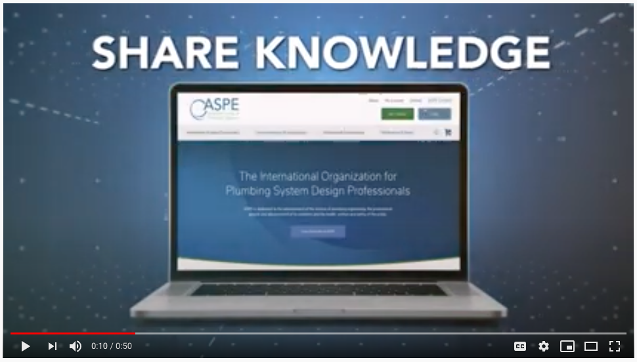
ASPE Connect Promotional Video + Anniversary
youtu.be/9Y76txSdFqk

Slide 45
ASPE Education

Slide 46
Education – Workshops
Phoenix – Feb. 2020
  Basic Plumbing Design II
  Engineering Out Legionella: A Workshop
Atlanta – Feb. 2020
  Engineering Out Legionella: A Workshop
  Thanks to Newcomb & Boyd for hosting (Amanda Askew and Dennis Connelly)
Revit
  Held remotely in May and June 2020, and more planned
What does your Chapter want to learn about this coming year?
aspe.org/education-credentialing/cfp/
  Linked on Education main page

Slide 47
Education – 2020 Webinars
Siphonic Roof Drainage (Sponsored by MIFAB)
August 2019
Plumbing System Commissioning
September 2019
Miami-Dade – the Future of FOG (Sponsored by IPEX)
December 2019 – Free for members
Steam Systems Design (Two-part Webinar)
January 2020
CPVC for Commercial Plumbing and Hydronic HVAC Applications (Sponsored by Corzan)
May 2020 – Free for members

Slide 48

ASPE and ASA Education Foundation Course
Three-hour FPS course
$100 for ASPE members
Self-paced
Hosted on ASPE Education

Slide 49


Joint Courses with ASA
American Supply Association Education Foundation has partnered
with ASPE to share five of their courses with ASPE members.
Can register for individual courses or the bundle to save.
  $100 – 160 per course; $575 for the bundle (15 hours)

Slide 50
Joint Courses with ASA
Fixtures and Faucets
Introduction to Copper Tube, Plastic Pipe, and Fittings
Introduction to Pipes, Valves, and Fittings
Introduction to Steel, Stainless Steel, Iron Pipe, and Fittings
Sump, Sewage, and Effluent Pumps

Slide 51
Chapter Meeting CEU Integration with
ASPE Education
44 Chapters have submitted meetings to have attendance CEUs integrated with ASPE Education.
Allows meeting attendees to retrieve CEU certificate automatically in education.aspe.org.
We strongly encourage Chapters to use this tool.
CEUs stay with the person even if they switch jobs or email addresses.

Slide 52
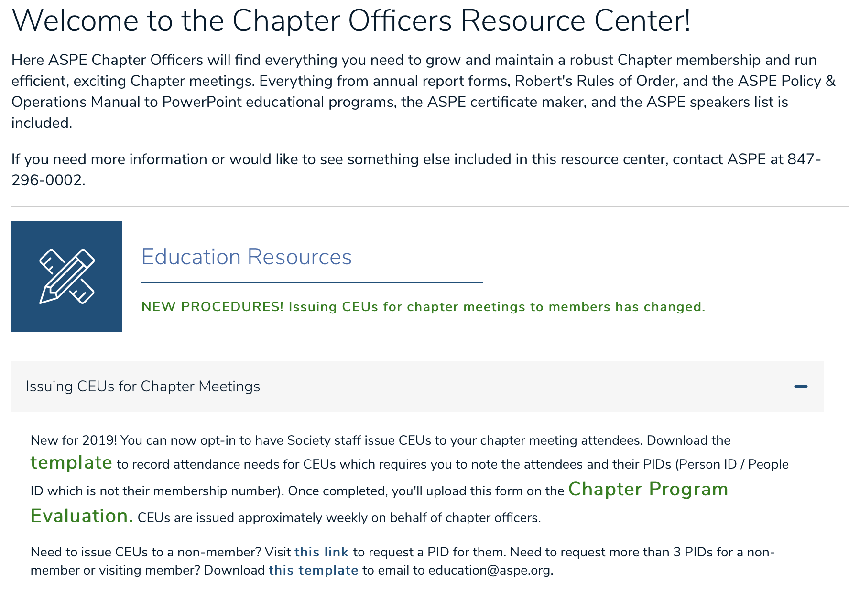

Slide 53
Chapter Meeting Integration During
COVID-19 Pandemic
Chapters have/had the ability to work with staff to integrate their monthly meetings with ASPE Education.
Allows for virtual participation and automatic application into attendee's education dashboard.
  No extra work for CEU reporting to have certificates issued.

Slide 54

Outreach to the Younger Generation
In 2017 the Education Committee compiled a packet of information for Chapters to use for school or youth
outreach events (STEM or STEAM, scouts).
  One packet for K-5, another for grades 6-12
More projects are forthcoming.

Slide 55
Credentialing & Certification

Slide 56

Certified in Plumbing Design (CPD)
Currently there are 1,139 CPDs.
2020 Exam was postponed to
June 15-21, 2020 due to COVID-19.
Practice tests are on education.aspe.org.
Review webinar series is on education.aspe.org.

Slide 57
CPD Review Classes (Society)
Society hosted classes again in 2020.
  Phoenix
  Atlanta (hosted at Newcomb & Boyd)
1.5-day classes include a mock test.
Expected to hold classes again in 2021.

Slide 58

Certified Plumbing Design Technician (CPDT)
Currently there are 122 CPDTs.
2020 Exam
  Exam dates are October 5-11, 2020.
  Exam registration opens June 15, 2020.
  Exam registration closes September 24, 2020.

Slide 59
CPD and CPDT Recertification
Recertification is now fulfilled on education.aspe.org.

Slide 60
Green Plumbing Design (GPD)
There are 172 current GPD certificate holders.
We are working on having this entirely online to open this up globally.

Slide 61
PE Working Group Update (PEWG)

Slide 62
PE Working Group Update (PEWG)
The WG continues pursuing State PE Board approvals of ASPE’s initiative of working to develop a plumbing option within the framework of the Mechanical Engineering Principals and Practice of Engineering Examination.
Our work follows the guidelines as administered by NCEES (National Council of Examiners for Engineering and Surveying).
Goals remain the same: ONLY for the inclusion of a plumbing option within the mechanical exam and NOT pursuing the development of a stand-alone discipline of Plumbing Engineering, like Civil, Electrical, Fire Protection, or Mechanical Engineering.

Slide 63
Plumbing Engineering Option Within the Mechanical Engineering Exam
State License Board contacted – need additional letters of support.
Initiative approved by State License Board.
Letters of support need to be sent to State License Board.
Face to face meeting – decision pending.
Face to face scheduled – pending rescheduled date.

Slide 64
ASPE Marketing

Slide 65
Marketing Update
ASPE.org:
After more than a year of dedicated efforts, our new website launched in November 2019. Visit aspe.org to see all of the improvements.
Website Videos:
We created two videos about the new website that were distributed via social media and ASPE Pipeline. The first was a promo and the second introduced users to the new features of the site.
ASPE Pipeline:
The new ASPE Pipeline website launched with the new ASPE website. It is being updated with news and information from ASPE, our Chapters, Affiliate Sponsors, partners, and the industry at large almost every day.
Visit aspe.org/pipeline often to stay in the know. The biweekly ASPE Pipeline e-newsletter is still being distributed every other Thursday as well.

Slide 66
Marketing Update
Get to Know:
Our new Get to Know initiative started on December 16 on ASPE Pipeline and social media.
The program's intent is to showcase members from a personal standpoint, rather than from a daily job perspective.
ASPE Videos:
We developed a marketing video about ASPE Connect for the one-year anniversary of the launch of this member benefit.
We are working on two more marketing videos specifically regarding ASPE membership.

Slide 67
Marketing Update
2020 ASPE Convention & Expo:
We have been working with our show manager to advertise this year’s Convention & Expo via all channels.
New this year is a dedicated Twitter handle where you can find the latest news and updates about the Convention and our exhibitors.
  Follow @ASPEExpo to stay informed. The hashtag this year is #ASPEConv2020.
We also are again partnering with CNTV to conduct interviews on the show floor for “ASPE Live.”

Slide 68
Marketing Update
Marketing Materials for Chapters:
You can find all of our current marketing materials in the Chapter Officers Resource Center on aspe.org.
These materials include the following infographics: Who Is ASPE?, What Is ASPE?, What Is a Plumbing Engineer?, What Is Connect?, Certified in Plumbing Design (CPD), and Certified in Plumbing Design Technician (CPDT).
You also can find ads and flyers for AYP, WOA, and the Mentoring Program.

Slide 69
Marketing Update
Affiliate Sponsor Profiles: We have started building webpages for each of our Affiliate Sponsors to provide more information about their companies. You can find them on the Affiliate Sponsor page of aspe.org.
Social Media: Get daily updates and news at:
  linkedin.com/company/american-society-of-plumbing-engineers
  facebook.com/AmericanSocietyofPlumbingEngineers
  twitter.com/ASPEorg
  twitter.com/ASPEexpo
  instagram.com/aspe.org
  youtube.com/channel/UCJFy5ih4JvM9KDBE3EOglRw
Chapter Flyers: For help with designing Chapter event flyers, contact nsaucedo@aspe.org.

Slide 70
ASPE Publications

Slide 71
Publications Update
Plumbing Engineering Design Handbook, Volume 3: This was updated in 2019 and distributed to ASPE members in good standing earlier this year. We once again received extraordinary volunteer participation from members and thank all of those who provided input.
Plumbing Engineering Design Handbook, Volume 4: Paul Baker, PE, CPD, GPD, of the Dallas/Ft. Worth Chapter is serving as Technical Editor to revise this volume, which will be distributed to members in good standing in early 2021.
Engineered Plumbing Design: David Dexter, FNSPE, FASPE, CPD, CPI, LEED BD+C, PE, of the Southwestern Ohio Chapter is serving as Chair of the project to revise this handbook. The estimated development timeline is 12 months.
Legionella Prevention Design Guideline: The Working Group has been formed and is writing this guideline based on an outline developed by Christoph Lohr, P.E., CPD, LEED AP BD+C, ASSE 6020.

Slide 72
Publications Update
Book of the Month: This member benefit program allows ASPE members to purchase one ASPE publication at a significant discount each month. Notification of the current Book of the Month is sent via eblast.
World Plumbing Day Discount: During the week of World Plumbing Day (March 9-15), we offered a special 20% discount to ASPE members for bookstore purchases.
Working Group 63 revised ARCSA/ASPE 63: Rainwater Catchment Systems, and it has been approved as an American National Standard.
The Working Group formed to develop ASPE 15: Hot Water Temperature Control has been tabled due to uncertainties in the industry regarding waterborne pathogen control.

Slide 73
2020 Convention & Expo Updates

Slide 74
Changes for 2020!
ASPE Breakfast Award Ceremony will start at 9:00 a.m.
No Keynote address will be held.
Society VIP Event will be held on Saturday, Sept. 12. We are working with a sponsor to assist in the cost to invite all Delegates and VIPs to a river boat cruise. Tentative arrangement to date.
Registration will have two locations. From Sept. 11–13, attendees can pick up their badges and packets at the New Orleans Marriott. After Sept. 13, badges can be picked up at the Morial Convention Center in front of Hall C.
We will continue with Member Loyalty & Certification Appreciation Breakfasts along with a First-Time Attendee reception.

Slide 75
Highlights
Delegate meeting will be held at the New Orleans Marriott (host hotel). The overflow hotel is the Sheraton. The hotels are located across the street from each other. Hotel rates are $189/night.
ASPE will provide bussing from the Marriott and Sheraton to the Morial Convention Center on September 14.
ASPE will use Halls C & D in the Morial Convention Center for the Expo and educational classes.
Sunday Night Party will be held at the House of Blues, which is a short walk from both hotels. Bradley Corporation is the sponsor.
Women of ASPE Leadership Forum will be held again on Friday, Sept. 11 at the New Orleans Marriott

Slide 76
Future Events

Slide 77
Symposium / Convention & Expo
2021 Technical Symposium San Diego | September 21-26, 2021
2022 Convention & Expo Indianapolis | September 16-21, 2022
2023 Technical Symposium Bellevue, WA | September 26 - October 2, 2023
2024 Convention & Expo Columbus, OH | October 15-24, 2024

Slide 78
Affiliate Relations

Slide 79
ASPE Affiliate Programs
Sponsor Program:
Continues to be an integral part of our Affiliate Program.
Staff continues to add to the benefits of being an Affiliate Sponsor.
  Sponsor profiles on aspe.org allow for additional information about our supporters, including video and social media links.
Delta Faucet continues to be the Exclusive Sponsor for the Women of ASPE.
Zurn continues to be the Exclusive Sponsor for ASPE Young Professionals.

Slide 80
ASPE Affiliate Programs
ASPE Pipeline:
New website format was introduced in late 2019.
  Continued expansion of ASPE Pipeline will be forthcoming.
Several advertising opportunities continue to be available.
ASPE Convention & Expo:
Sponsorship activity continues to be strong.
Product Showcase and Innovation Theatre continue to be popular.
Bradley Corporation is the sponsor of the Sunday Night Party at the House of Blues.
QuantumFlo will sponsor the Presidential Delegate and VIP Social – a new event!

Slide 81
Thank You!

